Slide 1
Comprehensive Redevelopment Project for Mohammadpur Government High School: Enhancing Academic Infrastructure and Sustainability
C2 Group- 3
1804165 - Shoeb Ahmad Tanim
1804173 - SM Nahian Al Wasi (GL)
1804176 – Abu Naser Khan
1804177 - Muhammed Yeasin Arafat
1804179 - Shamim Azad Bakul
1804180 – Samiha Tasneem (DGL)

Slide 2
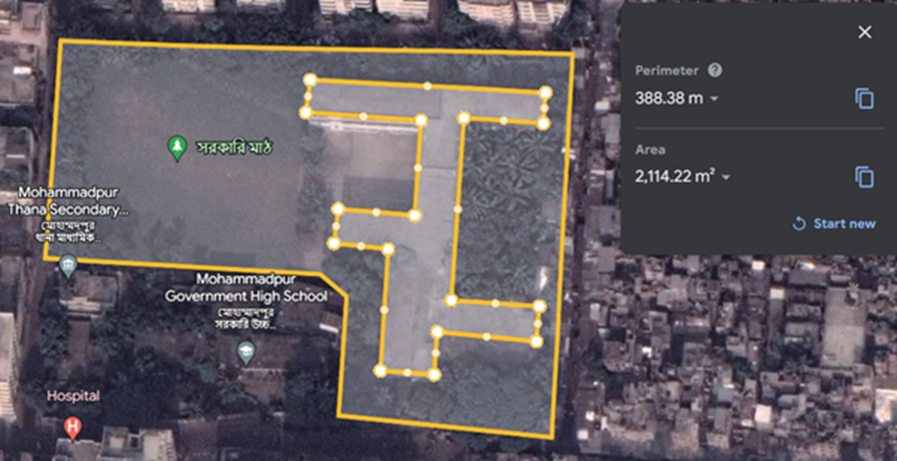
Location
Located at Mohammadpur
Established in 1967
Covers an area of 2,114 square meters

Slide 3
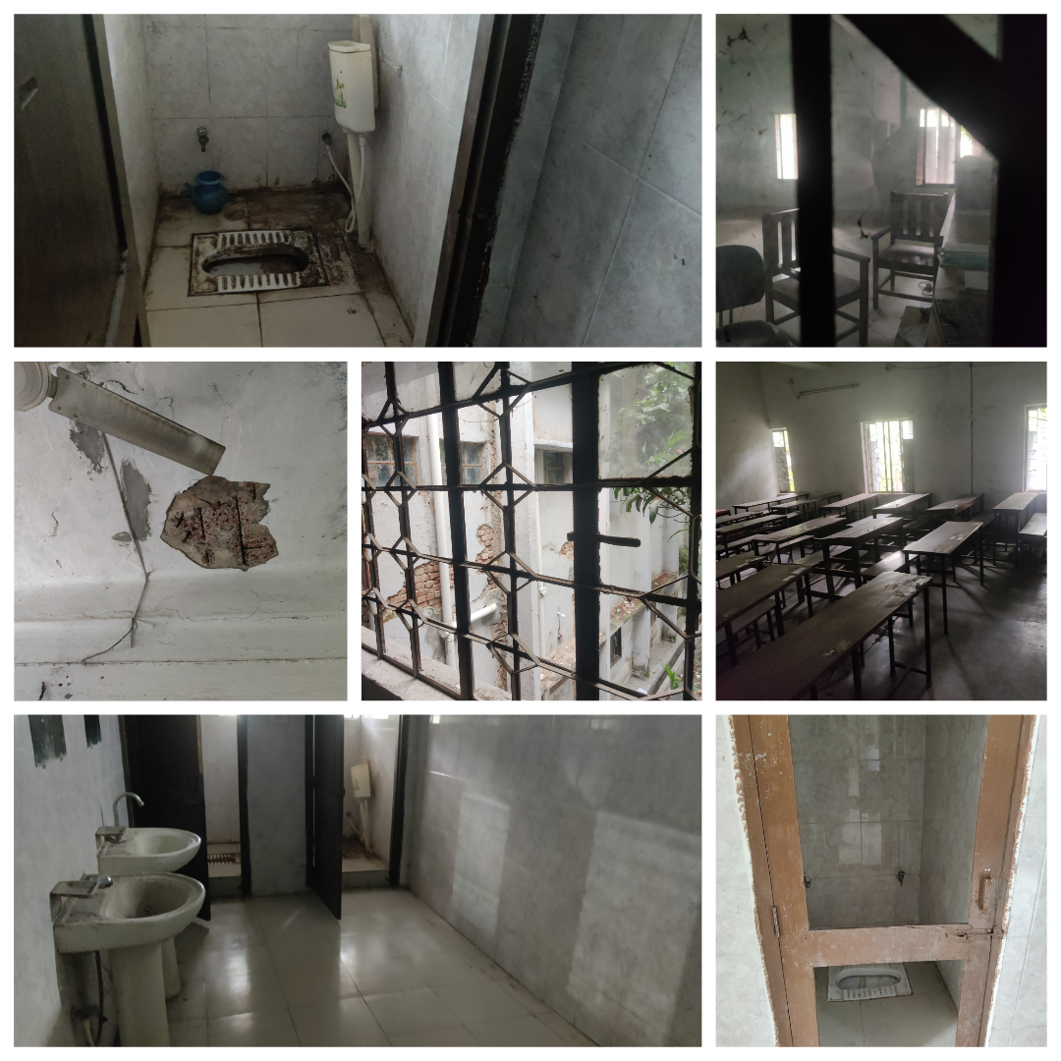
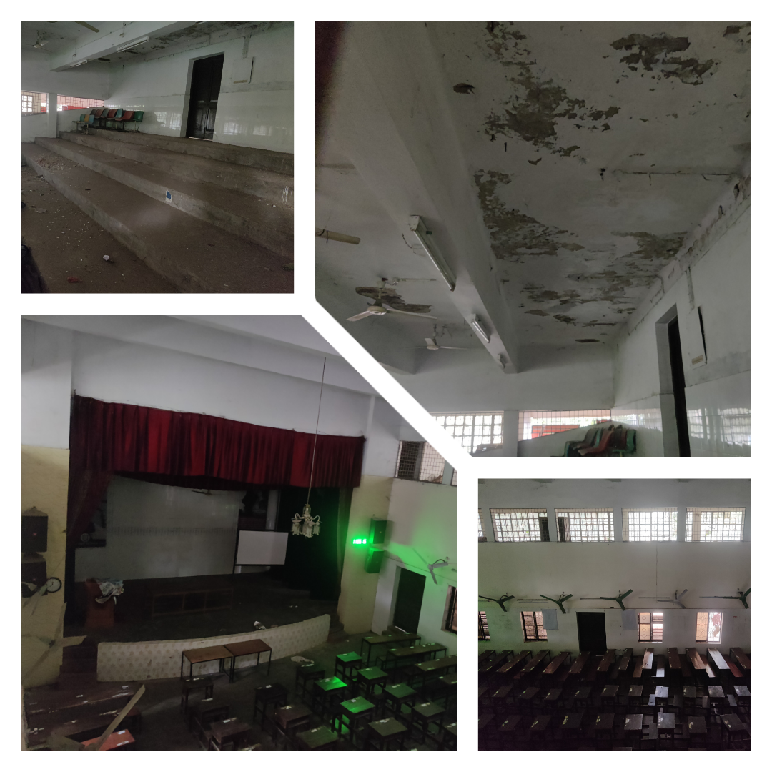
Current Condition of The School

Slide 4
Project goal
Modernize school, enhance infrastructure,
Focus
Improve facilities, integrate technology, implement sustainability
Current infrastructure
Cracked walls, damaged doors, worn-out flooring. Lack of digital facilities hampers teaching with technology.
Objective
Create ideal learning environment for students
promote sustainability
Project
Brief

Slide 5
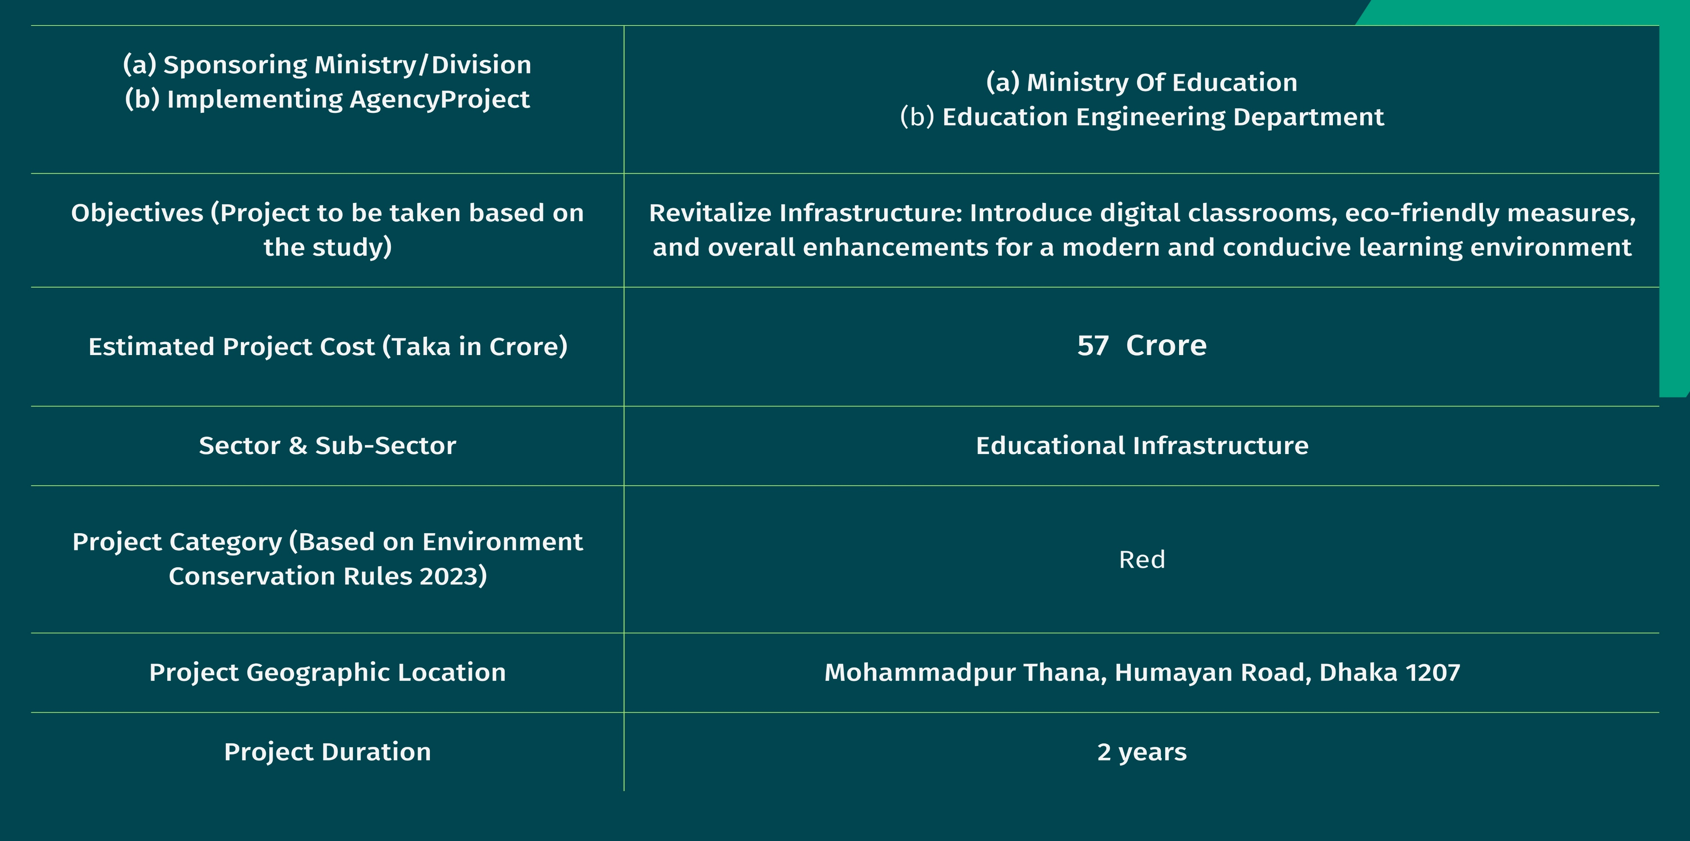
Project Description

Slide 6
Survey And Data Sources
Survey and Data | Data Collected
Archeological Survey | To ensure whether it is a historical building or not. It is not a historical site.
Google Earth Survey | To find the location, projected area, and adjacent road map.
Reconnaissance Survey | To evaluate the existing situation.
Soil Condition Survey | The Sub-surface Soil Investigation Report was collected from a nearby (within 200 meters) residential building project “Madhobilata” by Monico Ltd.
Questionnaire Survey | A survey was conducted among teachers, students, and guardians to assess present circumstances and anticipate future demand.
Traffic Survey | To estimate the parking area, sidewalk width, and demand for bicycle parking.
Engineering Survey | To find the existing plan and utility line layout.
School Office Survey | To find out the current students’ data and the classroom, lab, and teacher’s room demands.

Slide 7
Current Demand Analysis
Infrastructure Upgrade Urgency
Technology Integration
Co-curricular Facilities Alignment
Outdoor Spaces & Sports Facilities
Redevelopment Priorities
Future Demand Analysis
Significant Population Surge
Strategic City-Center Location
Proximity to Government Offices
Bihari Camp Adjacency
Catering to Community Needs
Modern Educational Infrastructure
Demand Analysis

Slide 8
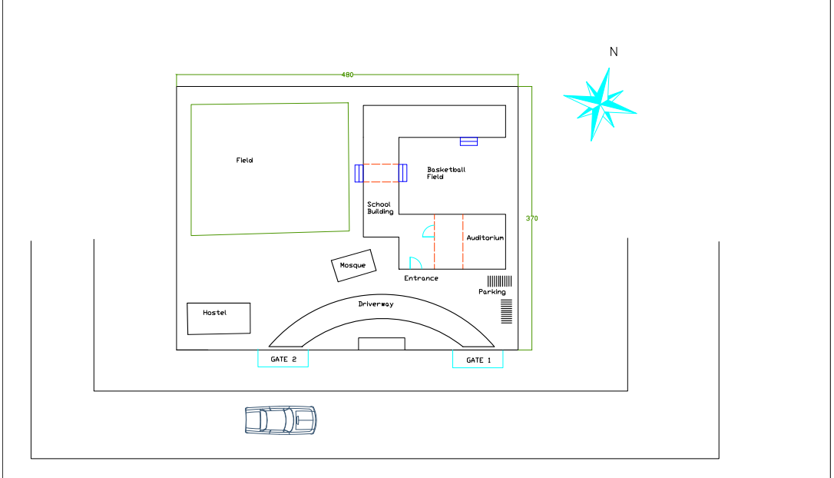
Analysis of Alternatives
The First Plan Layout
(Not Chosen)
Position of the field
Natural Light & Ventilation
Traffic Flow
Community Integration
Efficient use of space

Slide 9
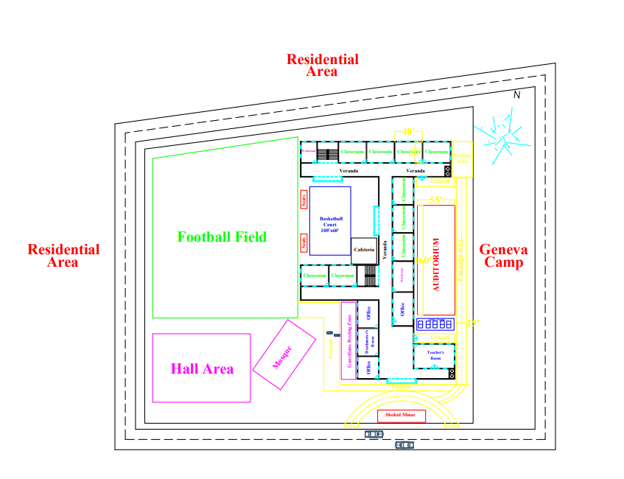
Analysis of Alternatives
The Second Plan Layout
(Not Chosen)
Parking Area and facility
Teachers Room Position
Stairs Position
Auditorium Orientation
Greenery
Washroom Orientation

Slide 10
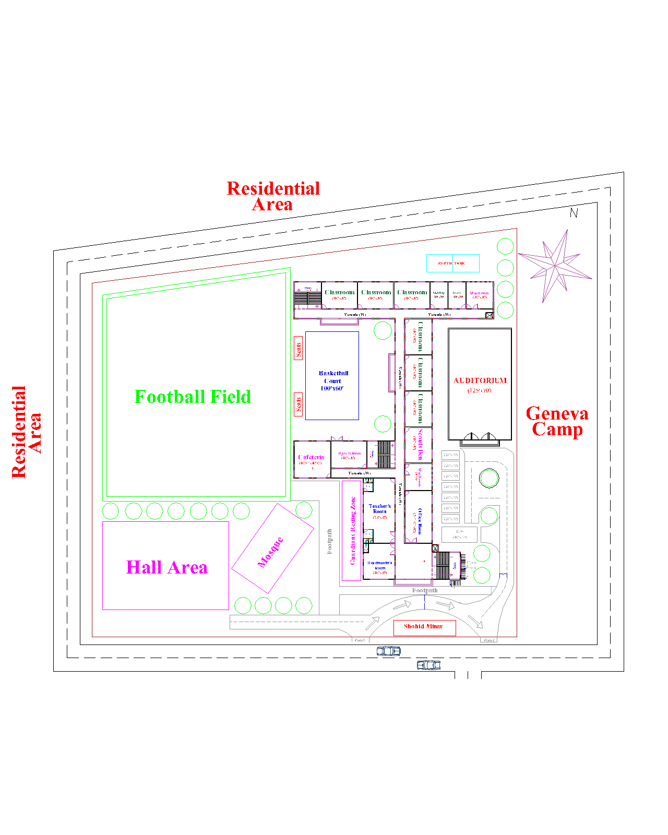
Analysis of Alternatives
The Final Plan Layout
(Chosen)
Enhanced Student Capacity
Aesthetic Consideration & View optimization
Utilization of GF
Enhanced Classroom & Labs
Amplified Auditorium Capacity
Ample Washroom Facilities
Better Parking facility

Slide 11
Final Analysis of Alternatives
Factors | Layout 1 | Layout 2 | Layout 3 (Selected Layout)
Enhanced Student Capacity | × | √ | √
Amplified Auditorium Capacity | × | × | √
Enhanced Classrooms and Labs | × | √ | √
Utilization of The Floor Area | × | √ | √
Ample Washroom Facilities | × | × | √
Aesthetic Consideration & View Optimization | × | √ | √
Better Parking Facilities | × | × | √
Corridor View Towards Football Field & Not Geneva Camp | × | √ | √
Teacher’s Room Location in A Place Where No Disturbance Will Occur. | × | × | √
Stairs Positions in Entrances. | × | × | √

Slide 12
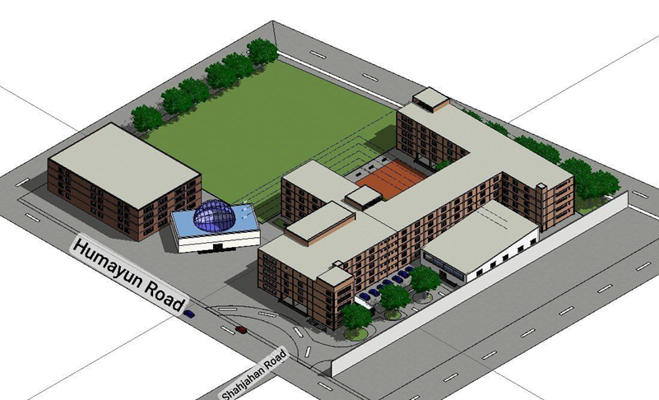
3D Site Model Using Revit 2024

Slide 13
5 Components of the Project
Academic Building
Auditorium
Parking Area
Football Field
Basketball Court
5 floors
43 classrooms accommodating 2752 students
Each classroom measures 40’x30’
125’ x 70’, accommodates 510 students
Front stage measures
25’ x 61’
2 bicycle stands
1 bus stand
7 car parking
360’x160’
Adheres to International standards
100’x60’
Adheres to International standards

Slide 14
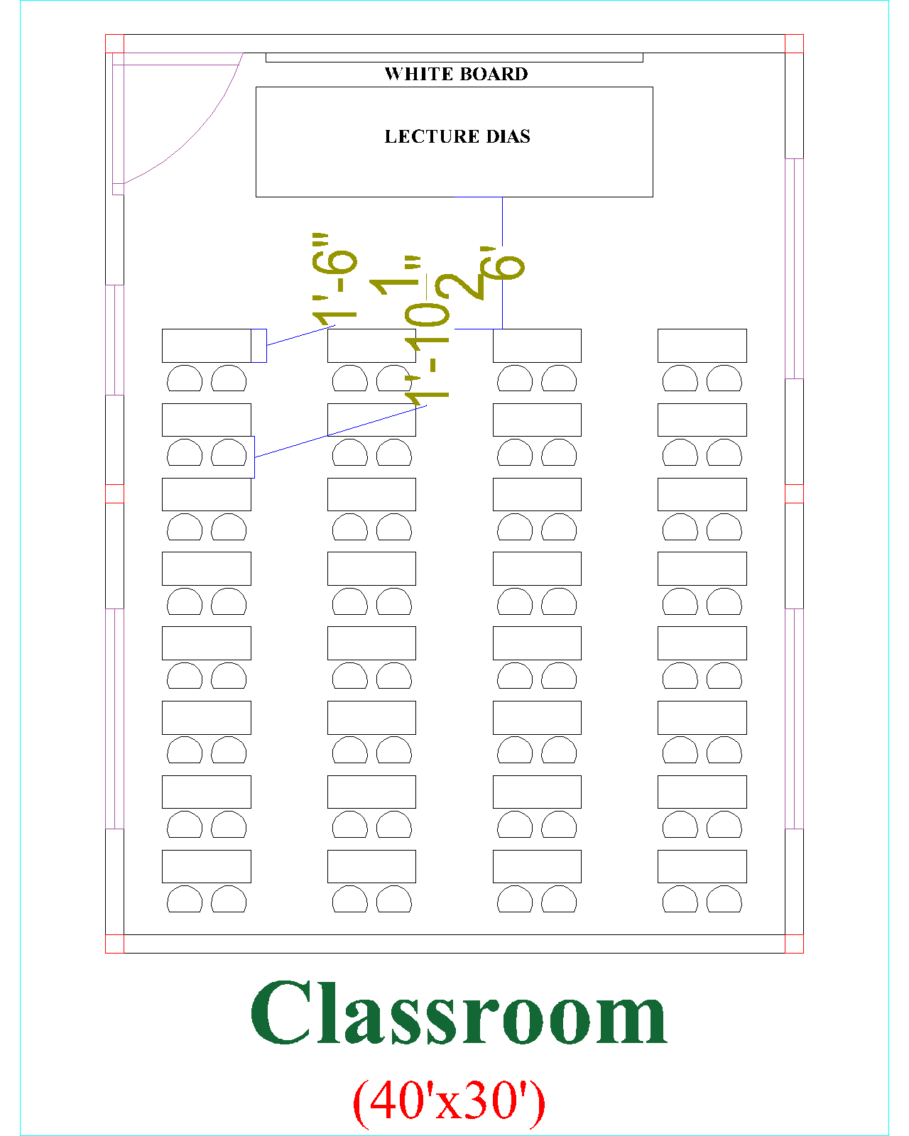
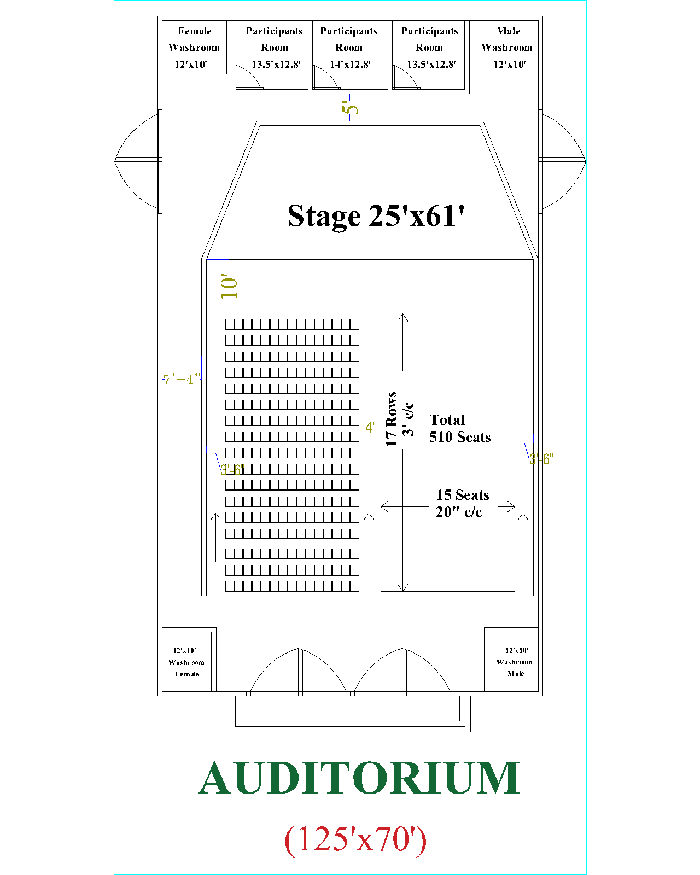

Slide 15
Project
Layout

Slide 16
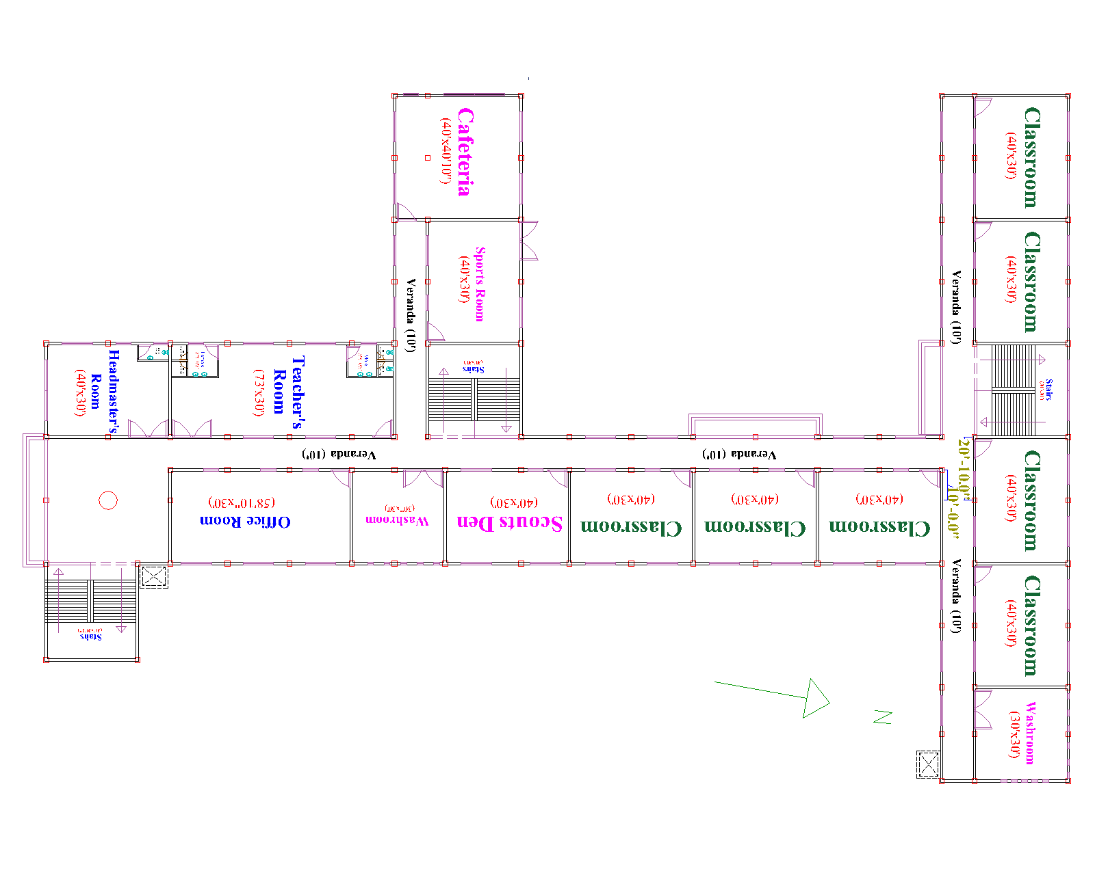
Typical
Floor
Plan

Slide 17
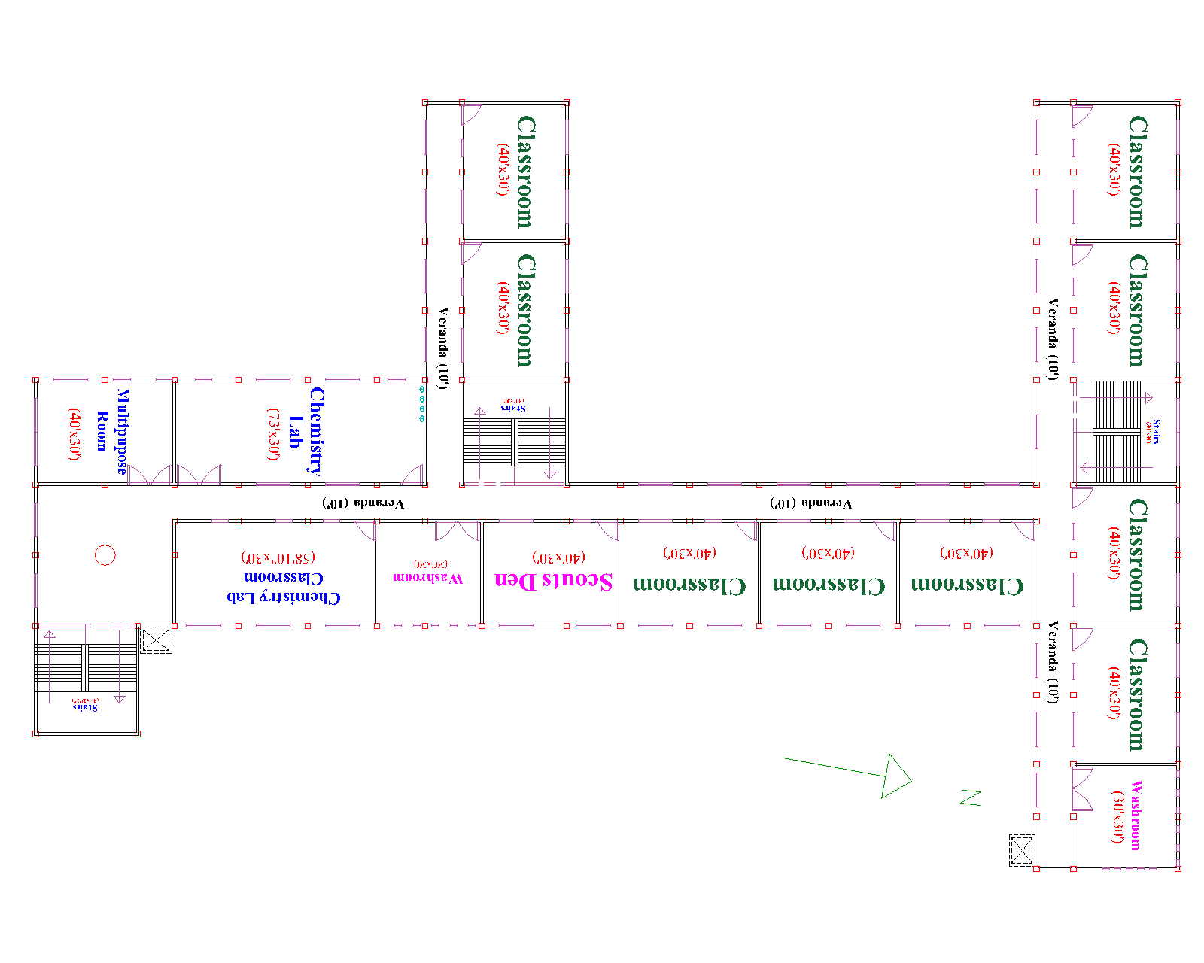
Typical
Floor
Plan

Slide 18
Comparison of Existing and Proposed Layout
Factors | Old Building | New Building
Floors | 3 | 5
Classrooms | 27 | 43
Students Accommodation | 1350 | 2752
Labs | Almost in Shut down situation | Modernized
Washroom | 3 Urinals and 3 Toilets | 7 Urinals and 6 Toilets
Auditorium Accommodation | 210 | 510
Sports Facilities | Football Field | Football Field, Basketball Field & Sports Room

Slide 19
Environmental Mitigation /Social Issues And Their Solution
The initial assessment of disaster resilience indicates that the project will not be immediately impacted
◊
Dhaka faces a medium risk of cyclones with a high level of exposure, as per the DRIP Basic Assessment of Disaster Resilience
◊
Dhaka is situated in seismic zone II, indicating moderate earthquake activity
◊
Environmental aspects are governed by The Environmental Conservation Act (amendment) 2010 and the Environmental Conservation Rules, 2023
◊
The Department of Environment (DoE), operating under the Ministry of Environment and Forest, serves as the regulatory authority responsible for enforcing the ECA’2010 and ECR’2023.
◊
IEE
EMP
EIA
Red

Slide 20
Environmental Mitigation /Social Issues And Their Solution
Construction Phase
Identification of Potential Impacts
& Mitigation
Pre-Construction Stage
Operational Phase
Land Clearing and Site Preparation
Vegetation Removal:
Site Grading and Excavation
EMP focuses on preparations
Cost : 4,12,000/-
Air Quality
Noise Pollution
Water Quality
Hydrology and Drainage
Biodiversity
EMP) intensifies its efforts through comprehensive environmental monitoring
Cost: 1,30,48,000/-
Traffic Congestion
Air Quality
Noise Pollution
Water Usage and Quality
Energy Consumption
Waste Management
Socio-Cultural Impacts
EMP shifts its focus to
long-term sustainability

Slide 21
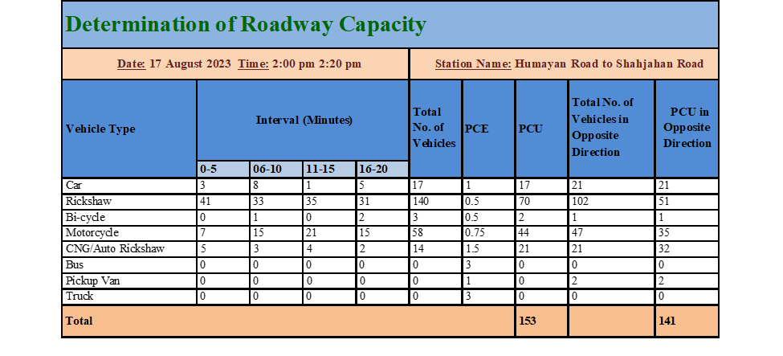
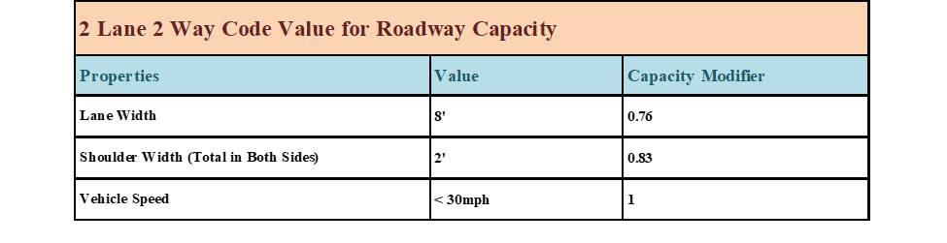
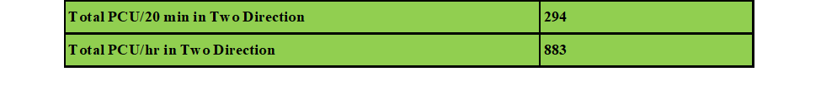
Transportation Issues And Their Solution
Calculated capacity: 1262 PCU/hr
Estimated capacity: 883 PCU/hr
Roadway capacity remains sufficient, eliminating the need for alterations

Slide 22

Economic Analysis
Economically Viable
Benefit to Cost Ratio: 1.79
IRR: 14% which is greater than discount rate 12%
Increased
Property
Values
Construction Cost
Job
Opportunities
Benefit
Cost
Enhanced Academic Quality
Maintenance
Cost
Long-Term Savings
Community Development
Ecological Consideration
Operation Cost
Geohazard Risk Elimination
Fire Safety Enhancement

Slide 23
Financial Analysis
Financially Not Viable
Construction Cost
The Benefit-Cost Ratio (BCR)
falls below 1
Benefit
Cost
Maintenance
Cost
Increased Student Enrollment
Potential for Future Expansion
Salvage Value
Operation Cost

Slide 24
Detail Design Report
Location: | Mohammadpur, Dhaka
Avg SPT value | 18
Allowable soil pressure | 6.34 ksf
Seismic zone | Zone II; Site Class: SC
Occupancy Category | Academic Building: III; Auditorium: III
Seismic Design Category | SC
Building Frame System | Intermediate Moment Resisting Frame
Foundation Type | Shallow Foundation (Isolation and Combined )
Building Code | BNBC 2020 , ACI code 318-14 ; referred to ASTM
RCC structure : Concrete Strength | 4 ksi
RCC structure : Reinforcement Strength | 60 ksi

Slide 25
Academic Building & Auditorium Structural Details

Slide 26
Beam Design And Detailing

Slide 27
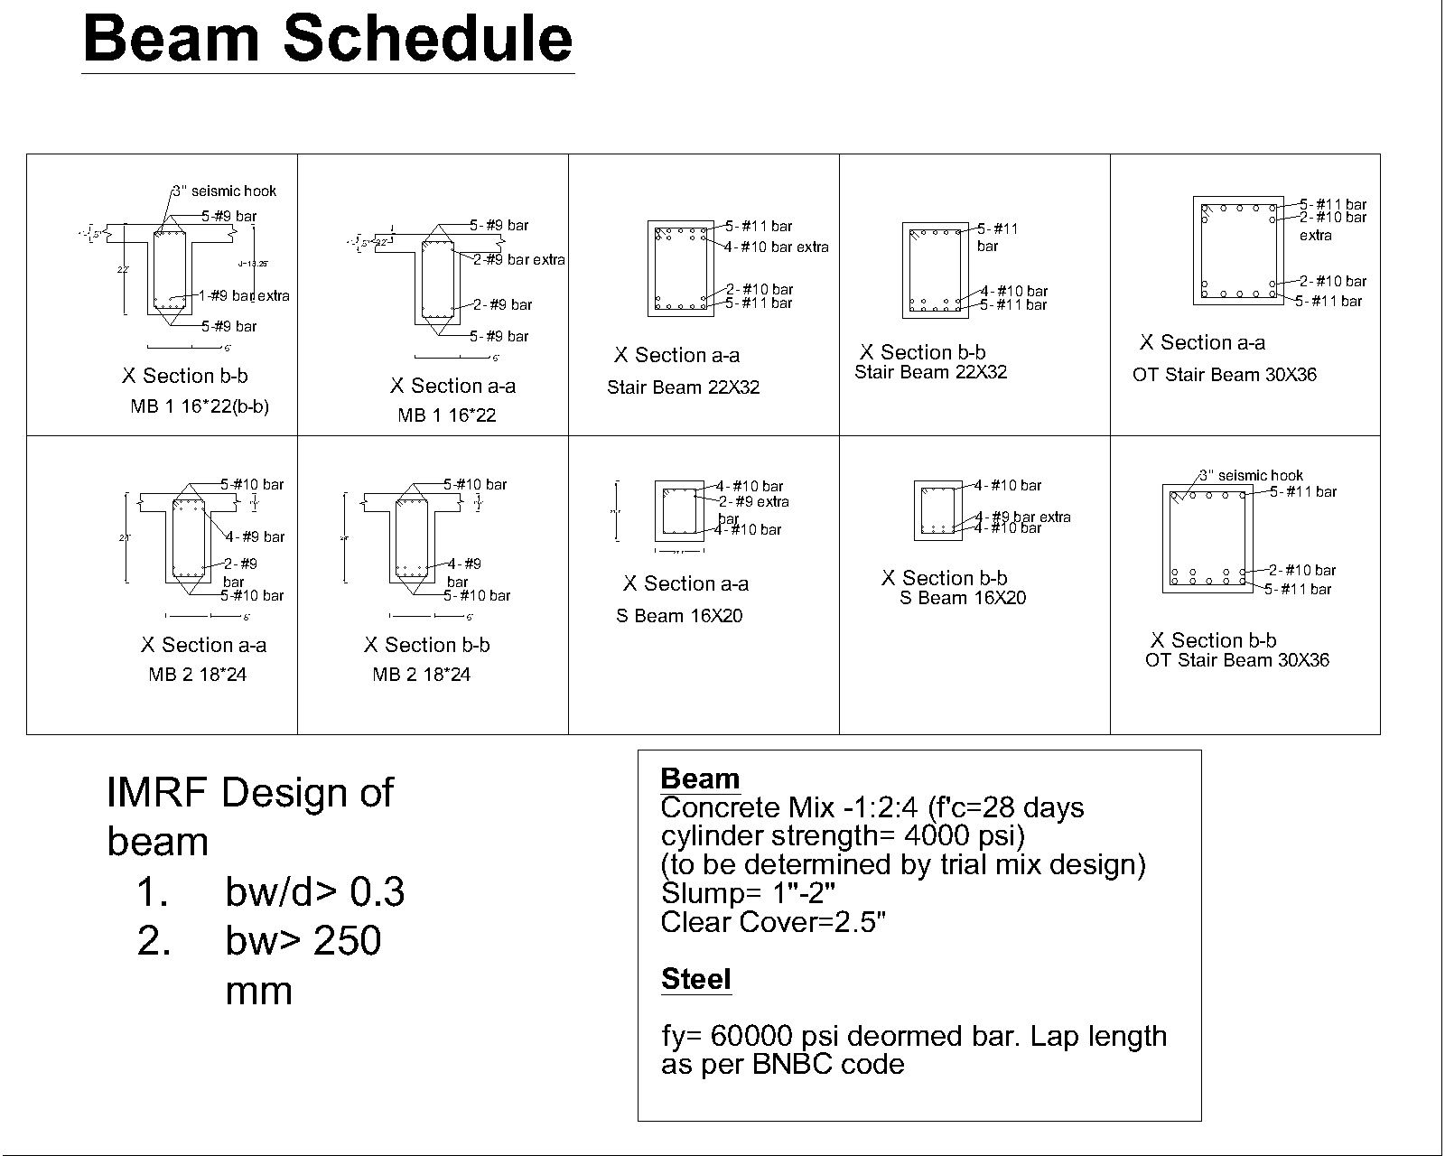
Beam Schedule

Slide 28
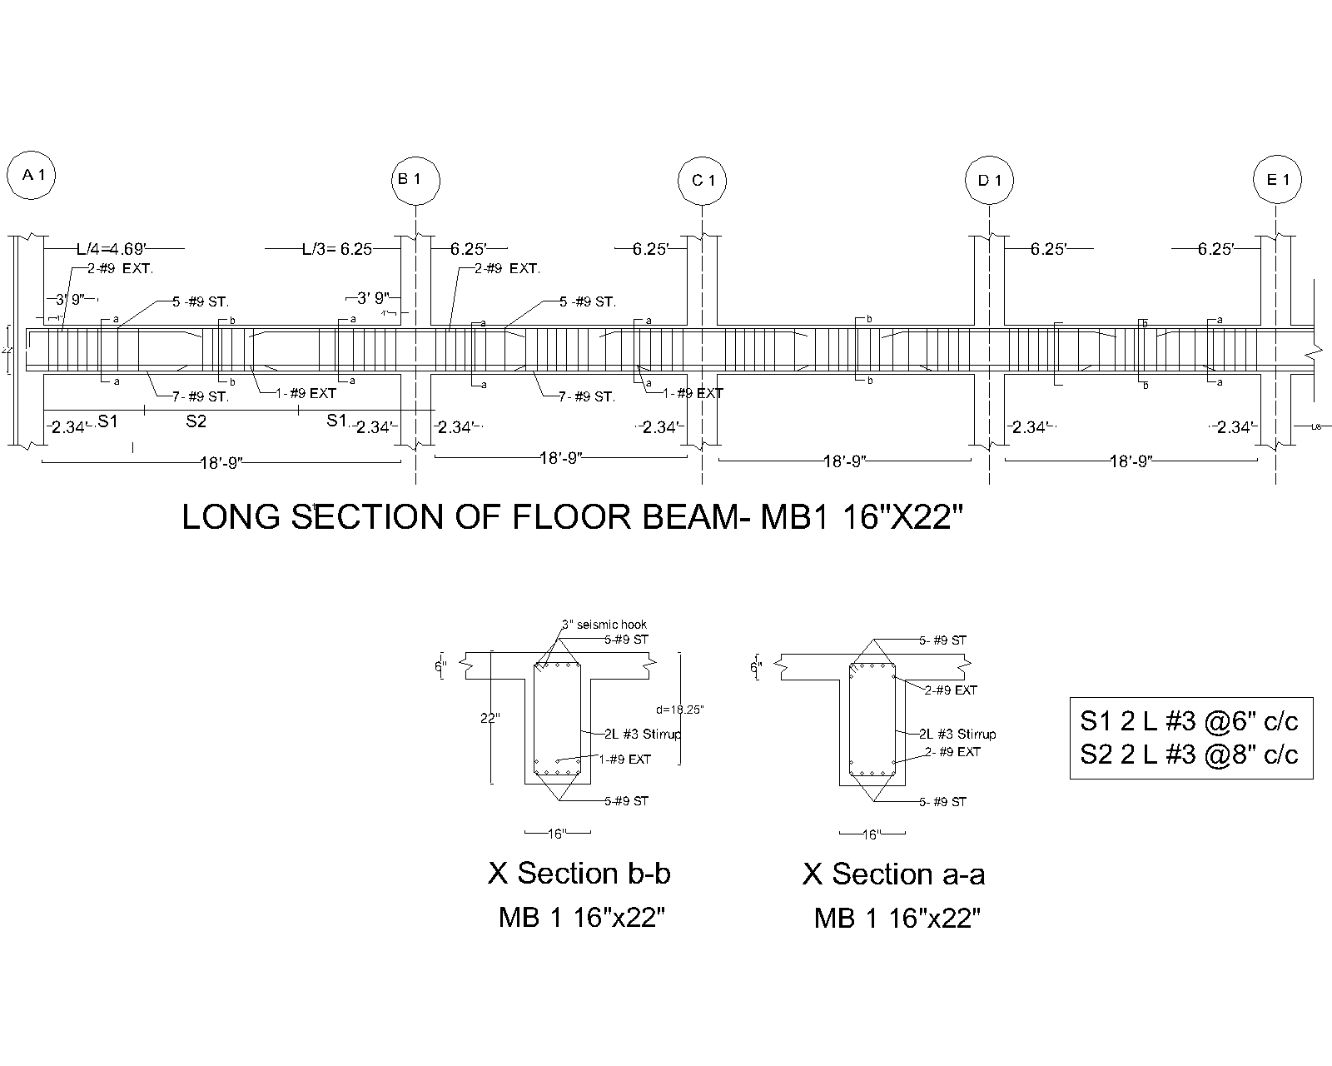
Typical Floor Roof Beam Reinforcement Details

Slide 29
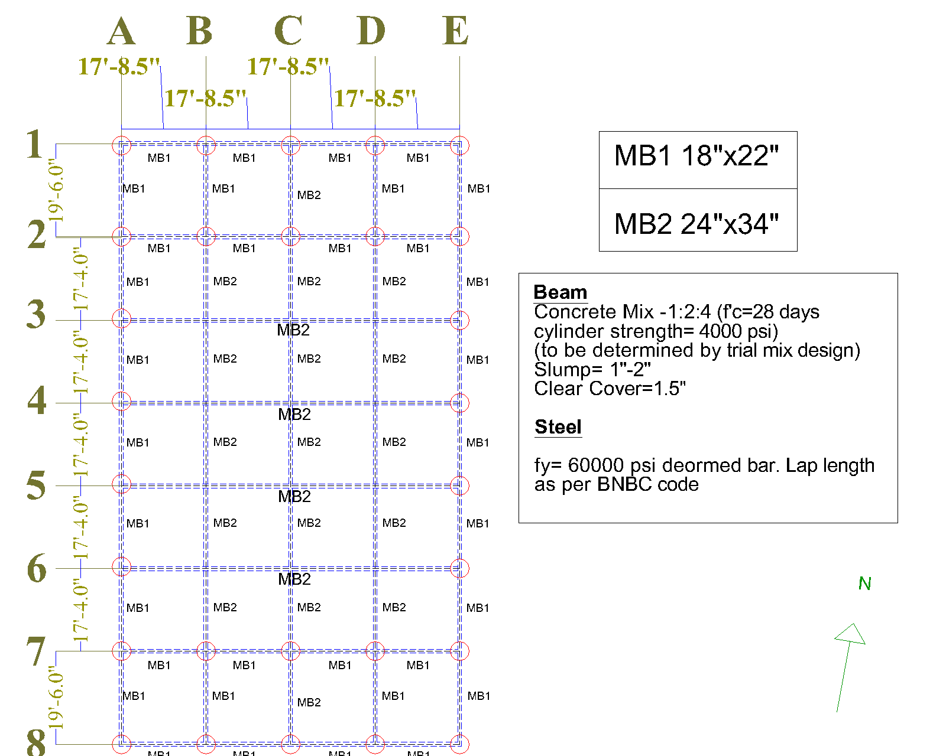
Auditorium Beam Layout

Slide 30
Grade Beam Detailing
& Layout

Slide 31
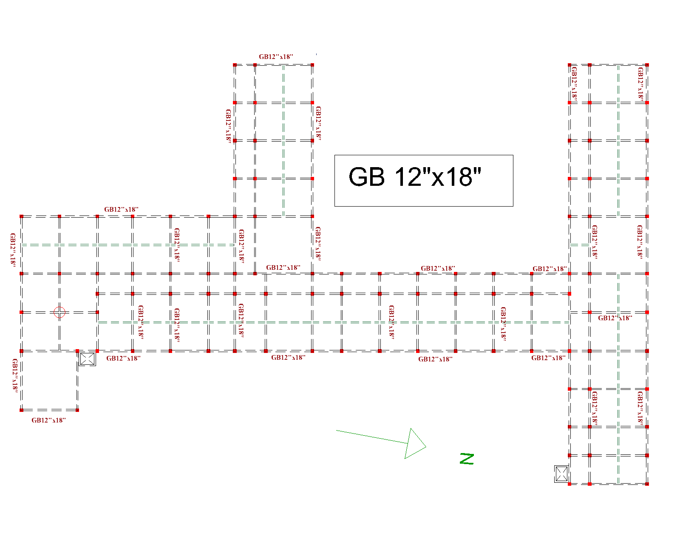
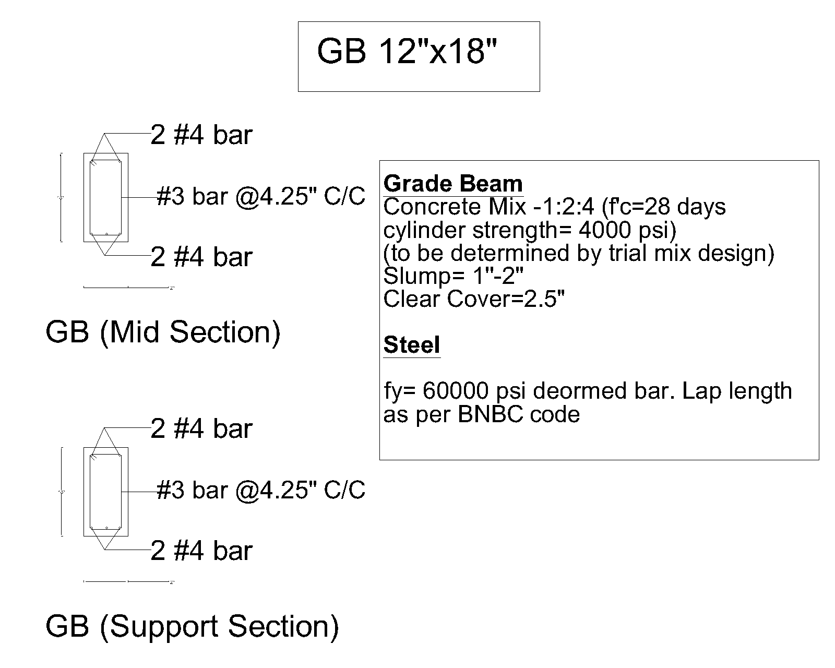
Academic Building Grade Beam Layout

Slide 32
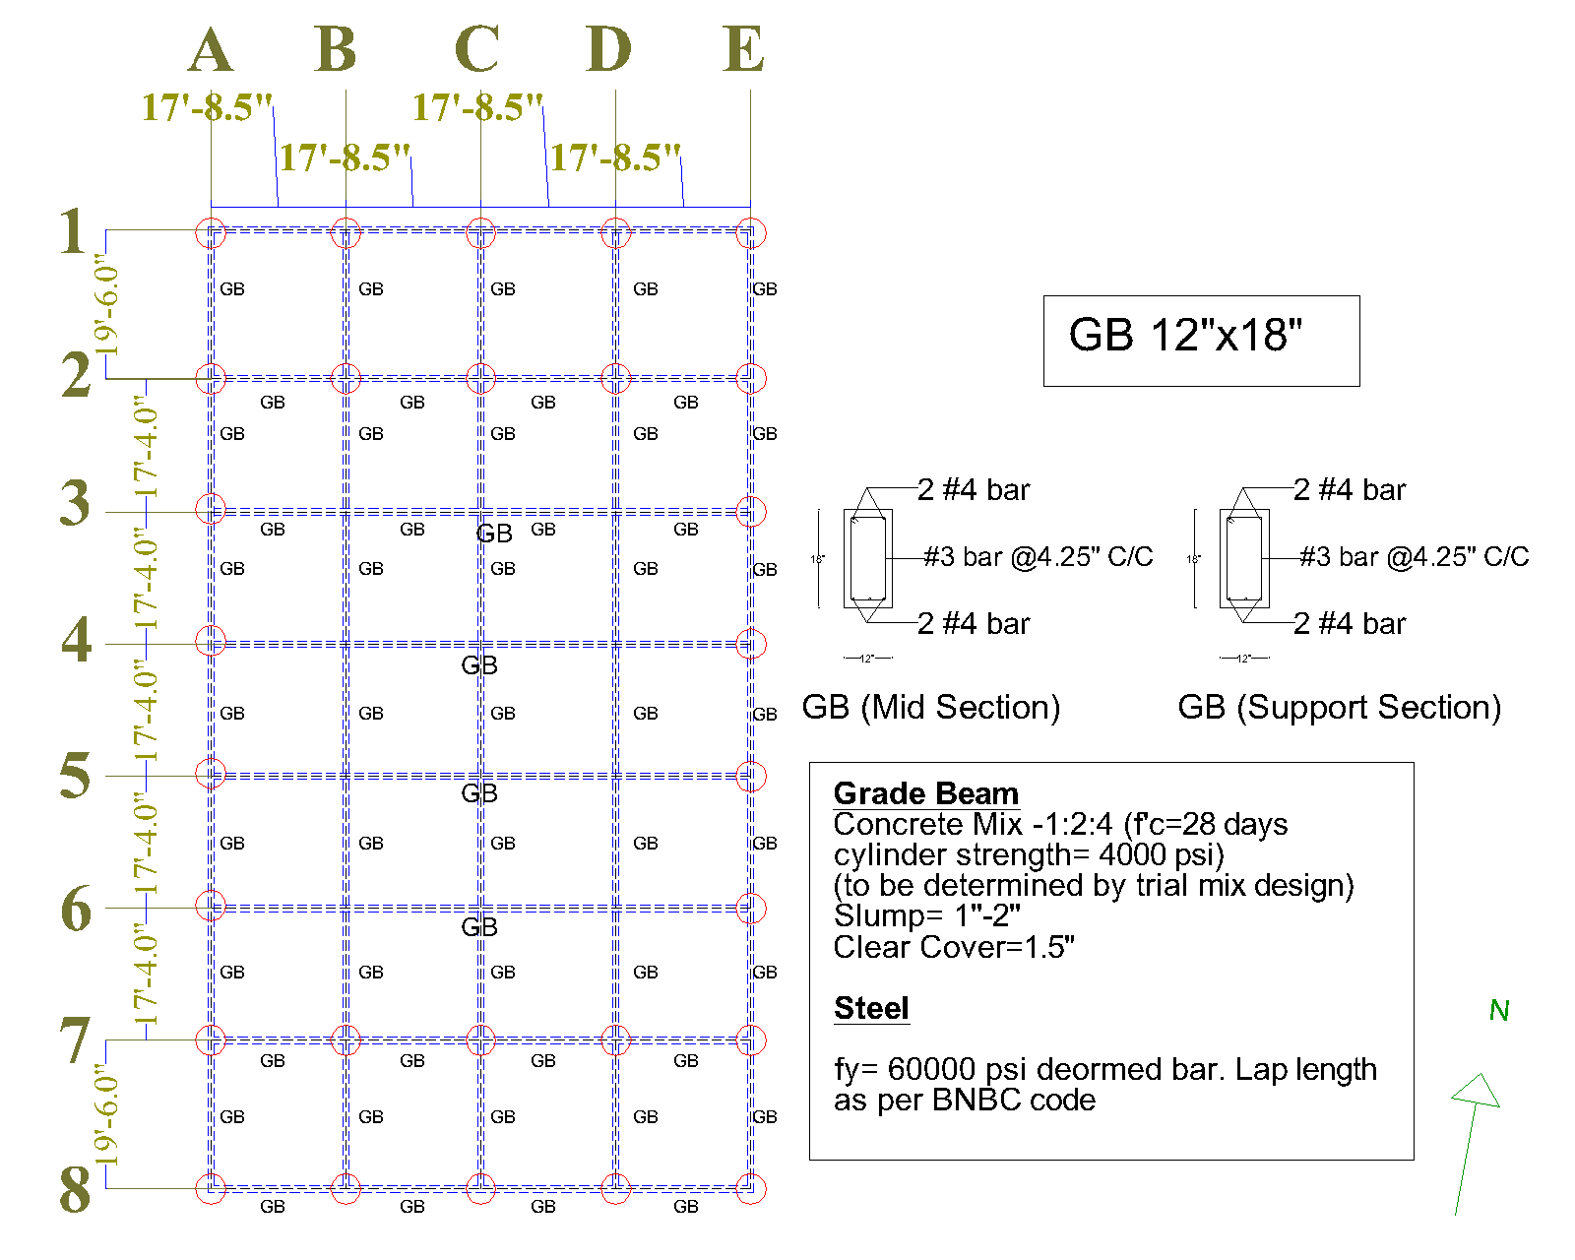
Auditorium Grade Beam Layout

Slide 33
Slab Design
And Details

Slide 34
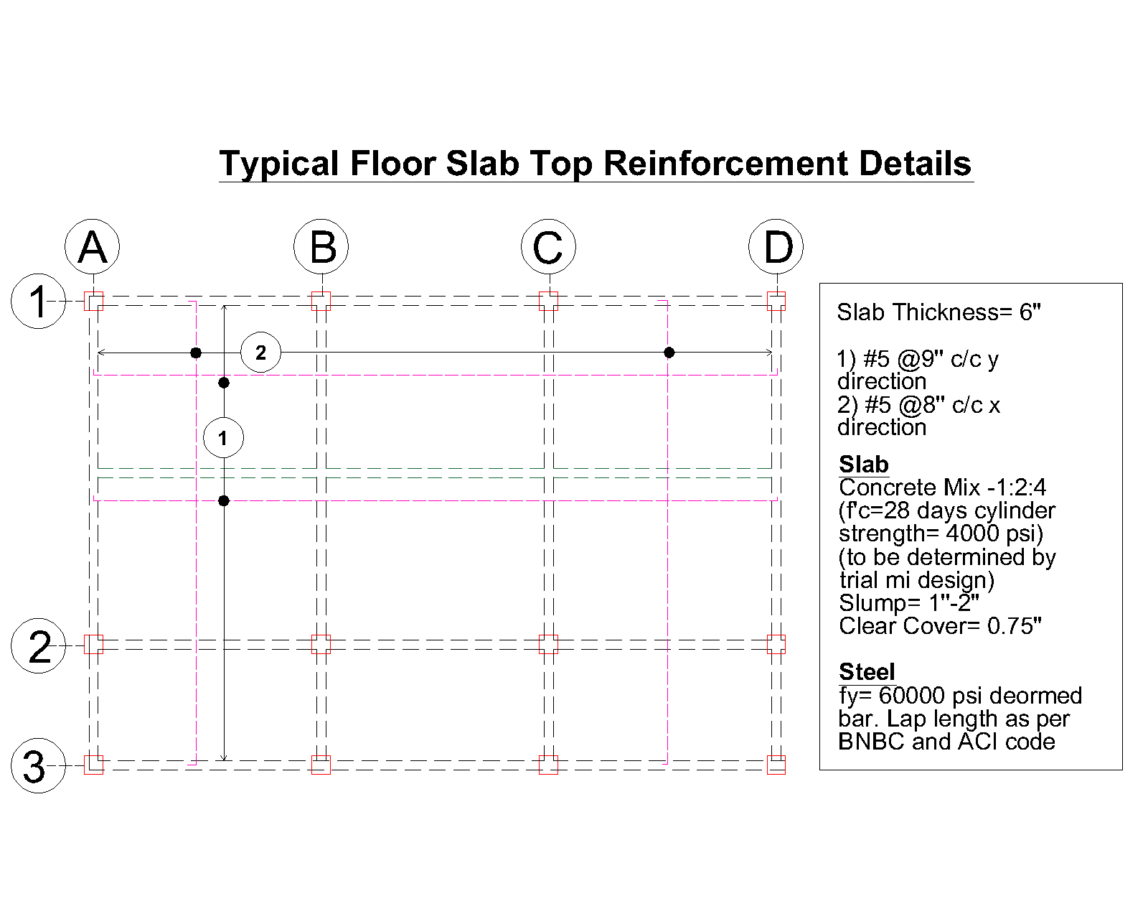
Typical Floor Slab Top Reinforcement Details

Slide 35
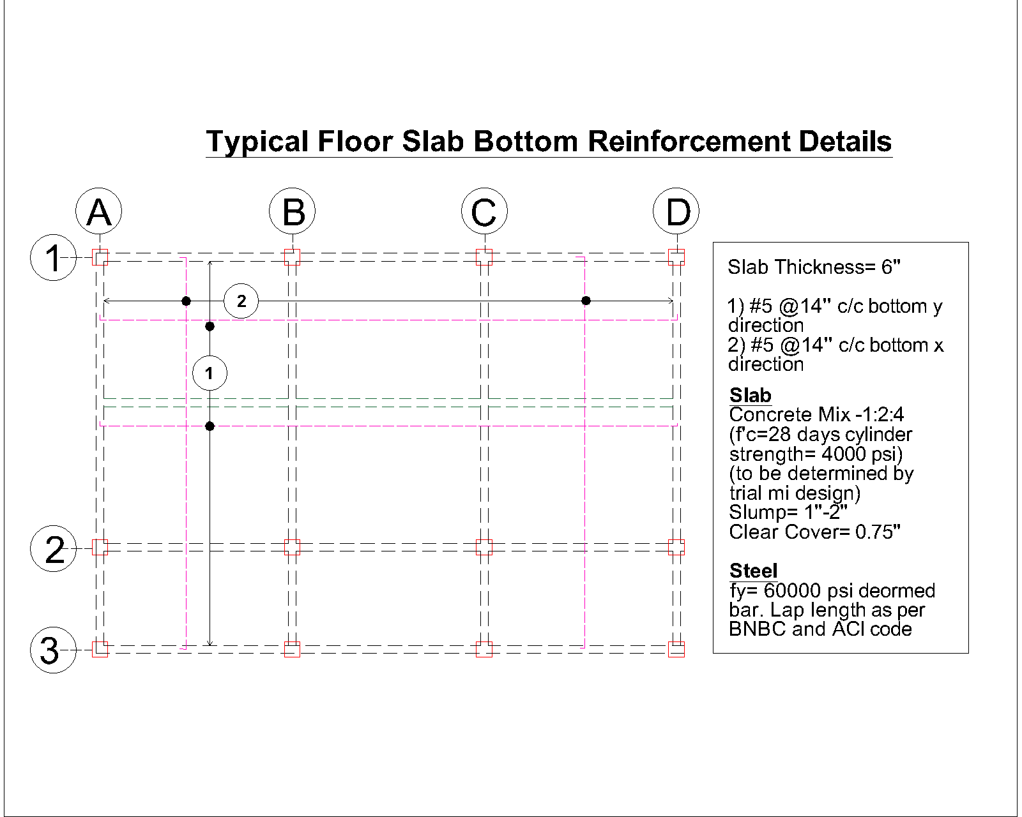
Typical Floor Slab Bottom Reinforcement Details

Slide 36
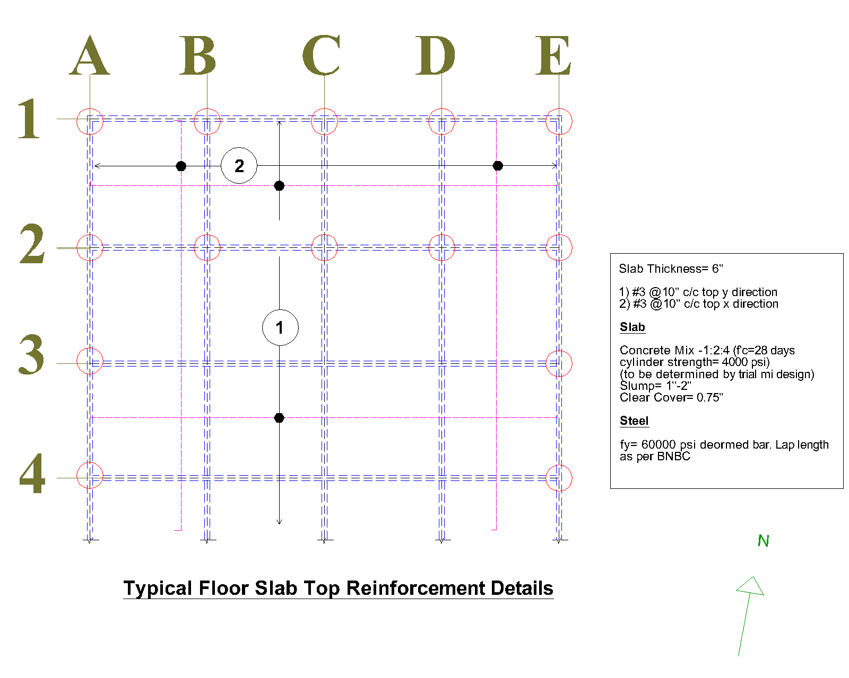
Auditorium
Slab Top Reinforcement Details

Slide 37
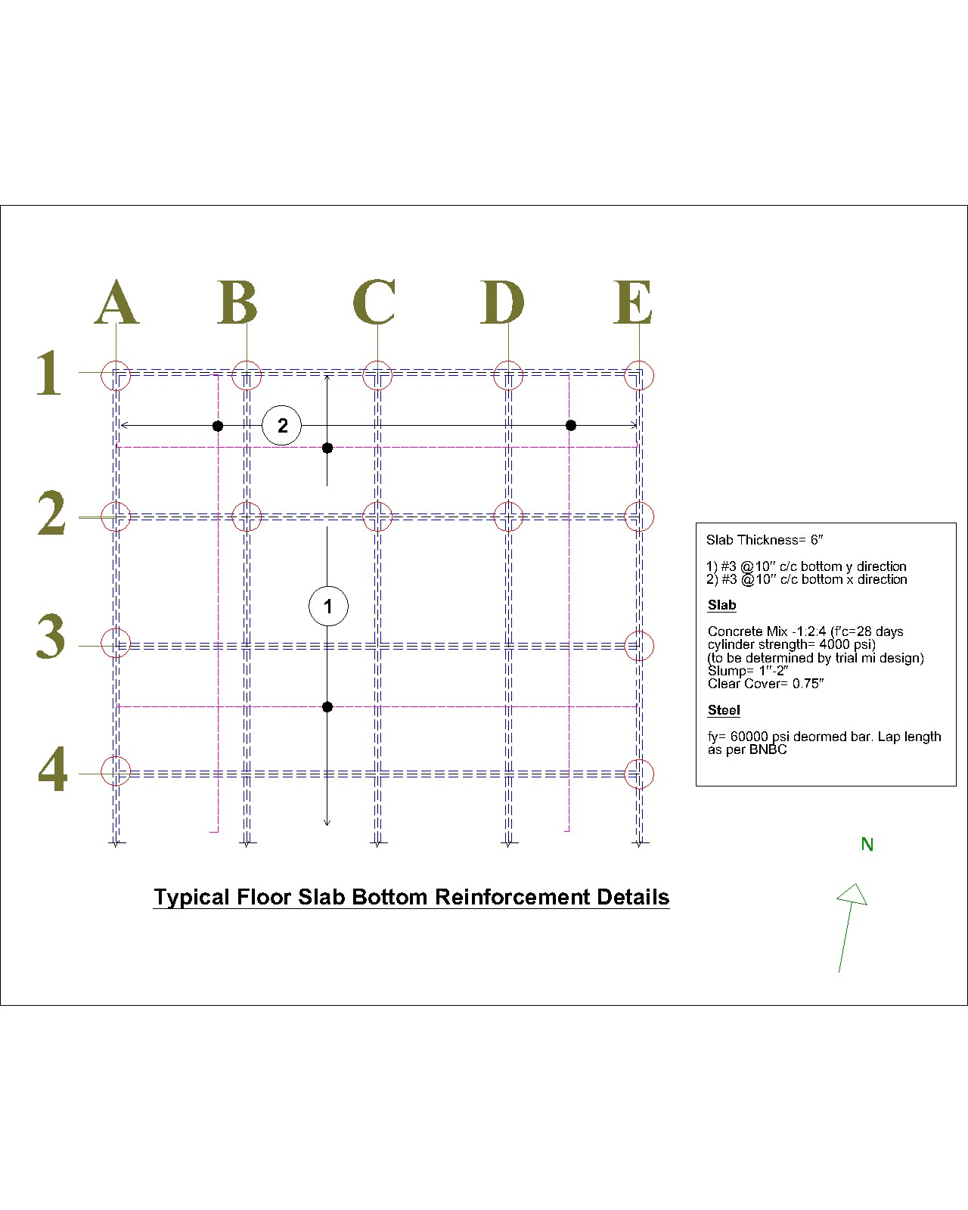
Auditorium
Slab Bottom Reinforcement Details

Slide 38
Column
Detailing

Slide 39
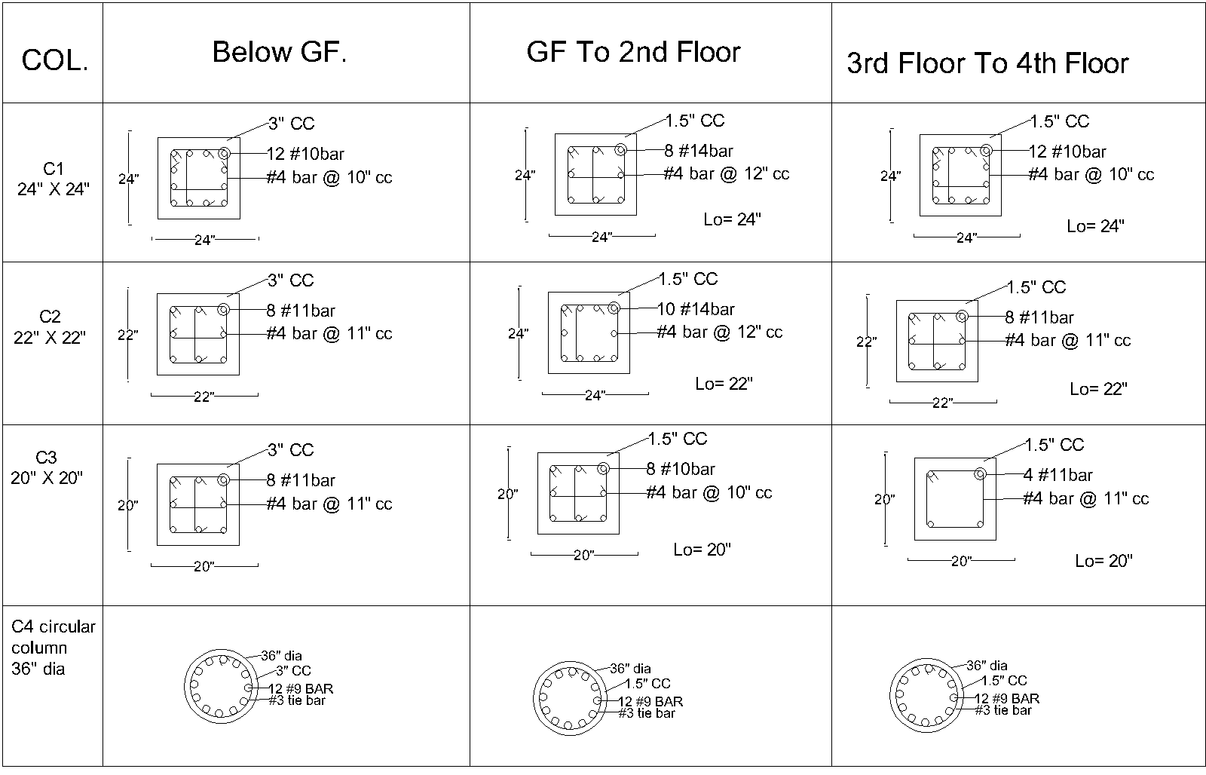
Schedule
of Column

Slide 40
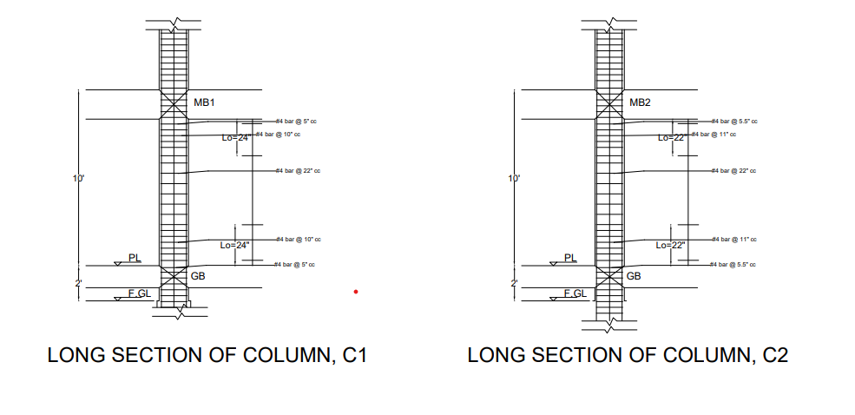
Long Section of Column

Slide 41
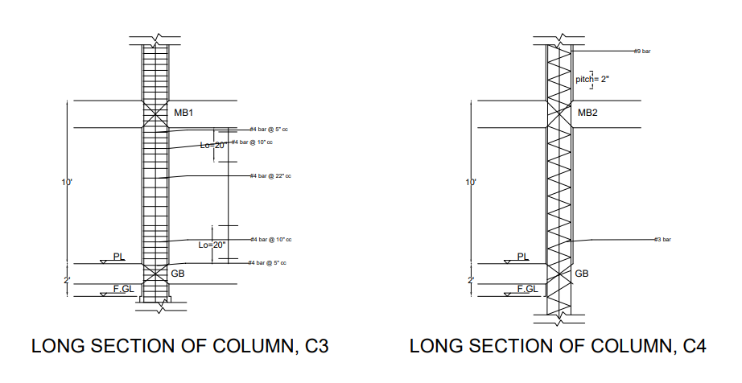
Long Section of Column

Slide 42
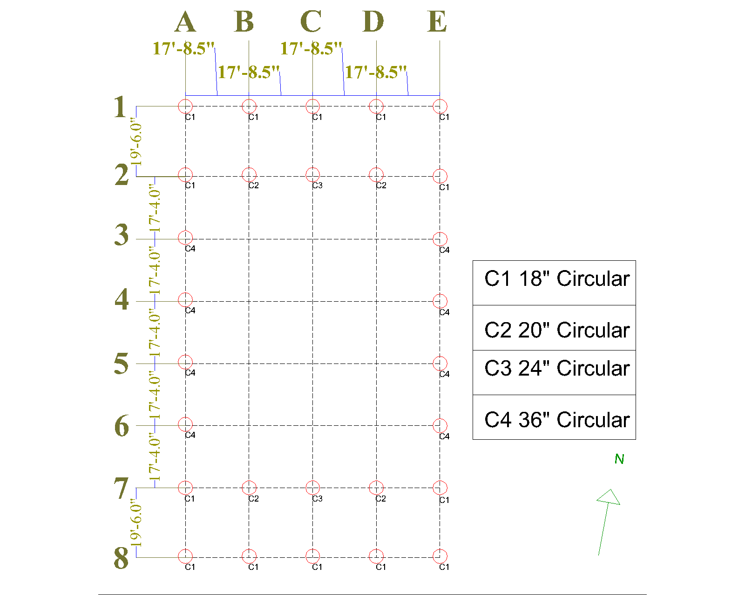
Auditorium
Column
Layout

Slide 43
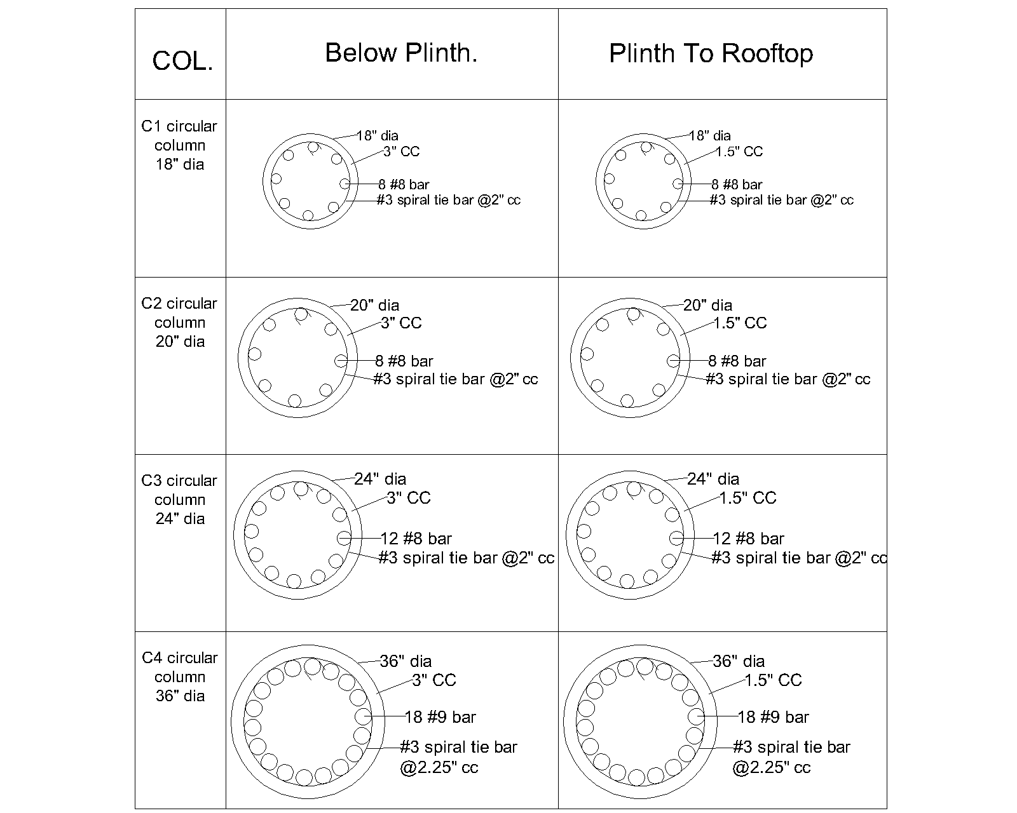
Auditorium
Column
Schedule

Slide 44
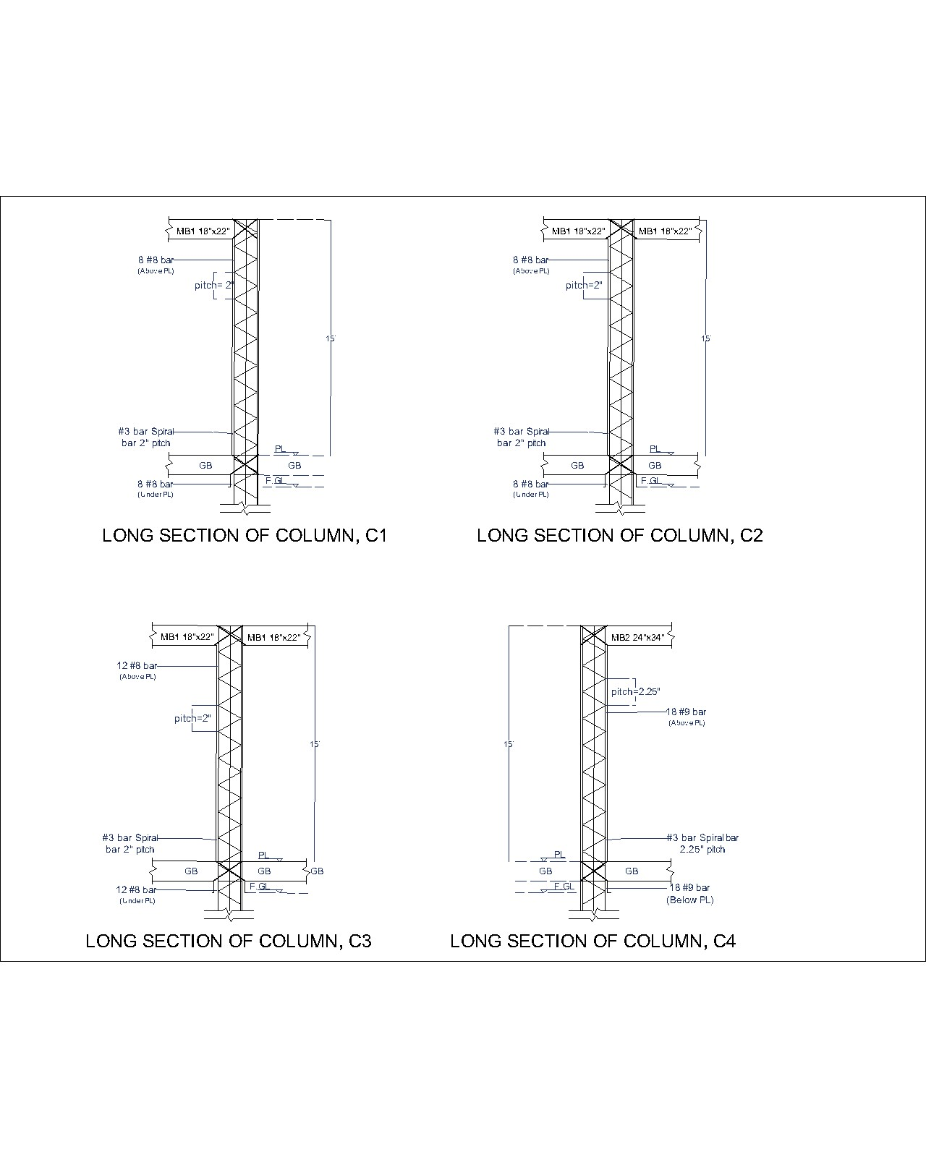

Slide 45
Stairs
Assumptions and Detailing

Slide 46
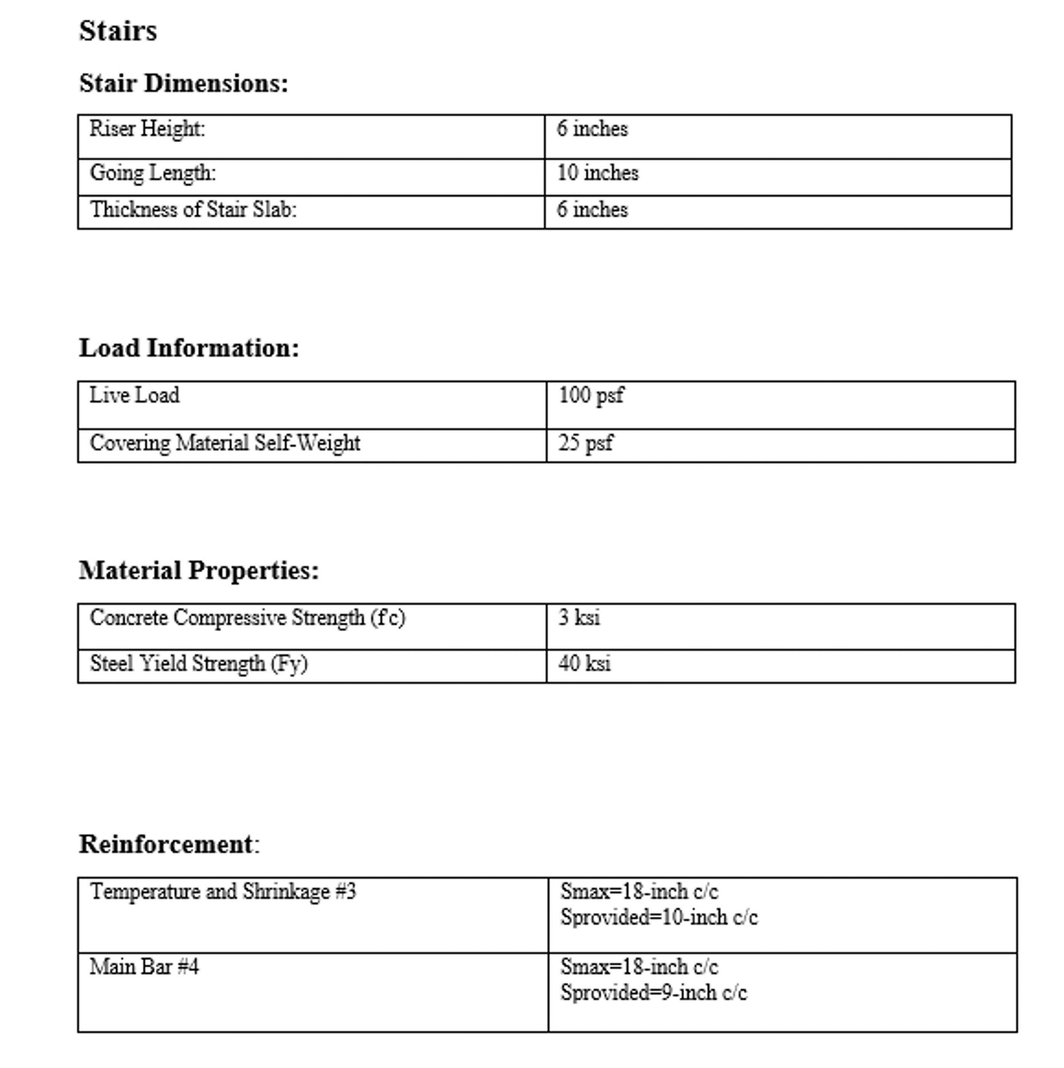
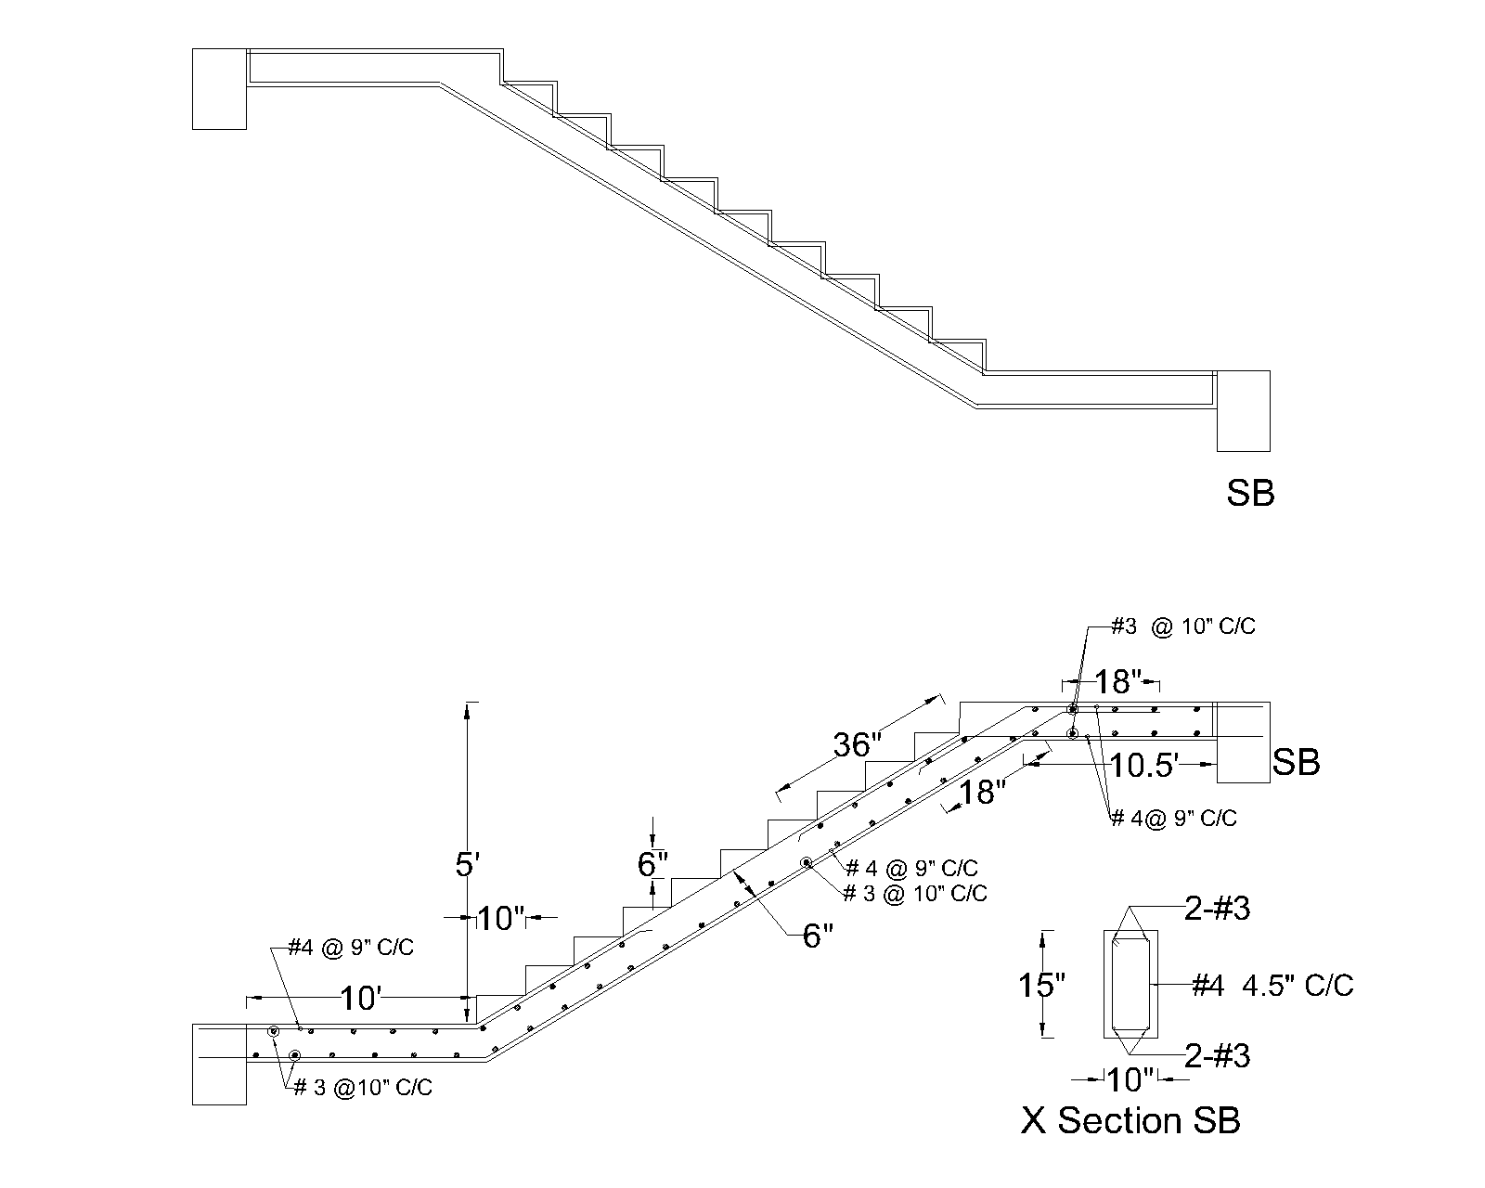
Detailing of Academic Building Stairs

Slide 47
Footing Design & Detailing

Slide 48
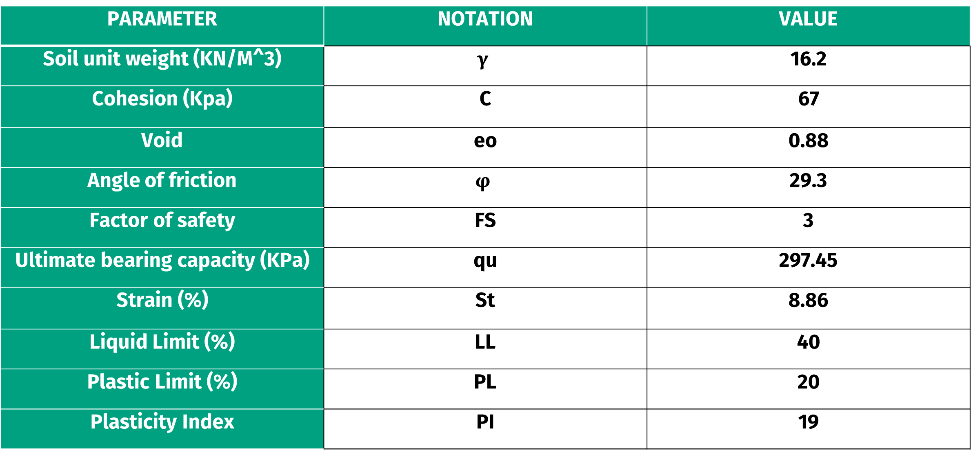
Soil Properties
PARAMETER | NOTATION | VALUE
Soil unit weight (KN/M^3) | $$γ$$ | 16.2
Cohesion (Kpa) | C | 67
Void | eo | 0.88
Angle of friction | $$φ$$ | 29.3
Factor of safety | FS | 3
Ultimate bearing capacity (KPa) | qu | 297.45
Strain (%) | St | 8.86
Liquid Limit (%) | LL | 40
Plastic Limit (%) | PL | 20
Plasticity Index | PI | 19

Slide 49
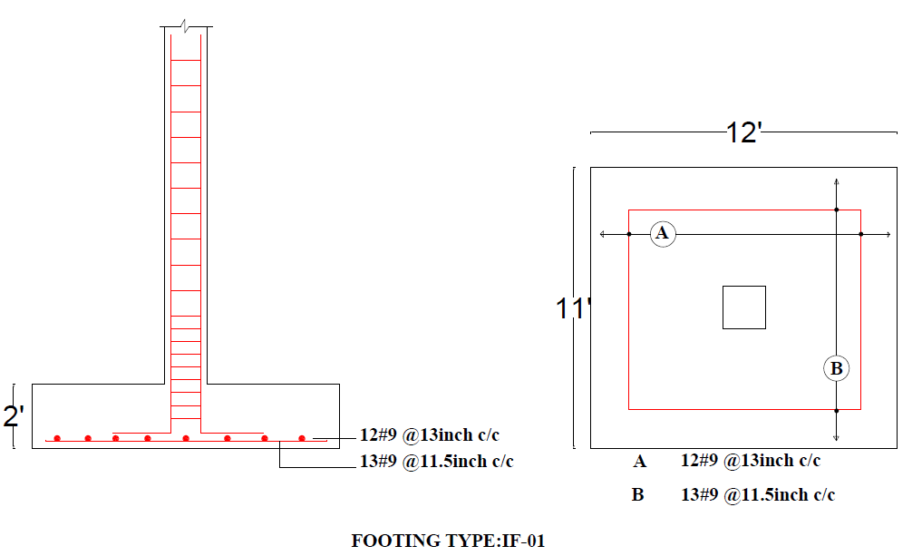
Detailing of Isolated Footing- Type 1 (Academic Building)

Slide 50
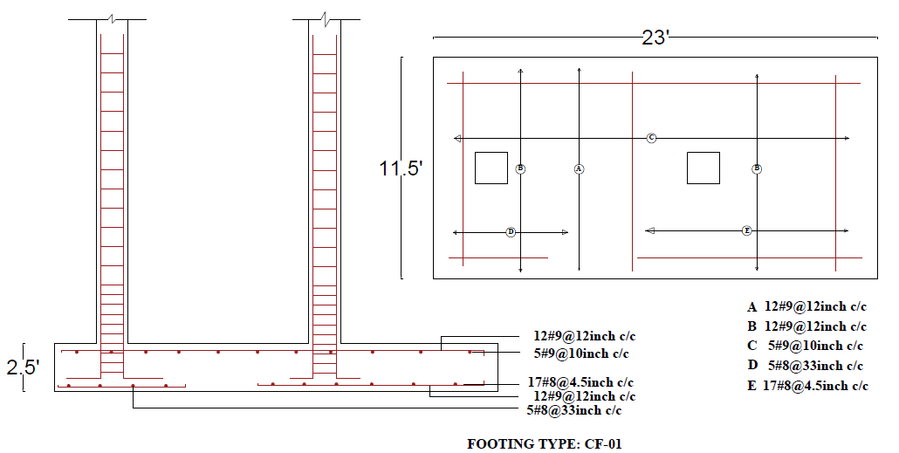
Detailing of Combined Footing- Type 1 (Academic Building)

Slide 51
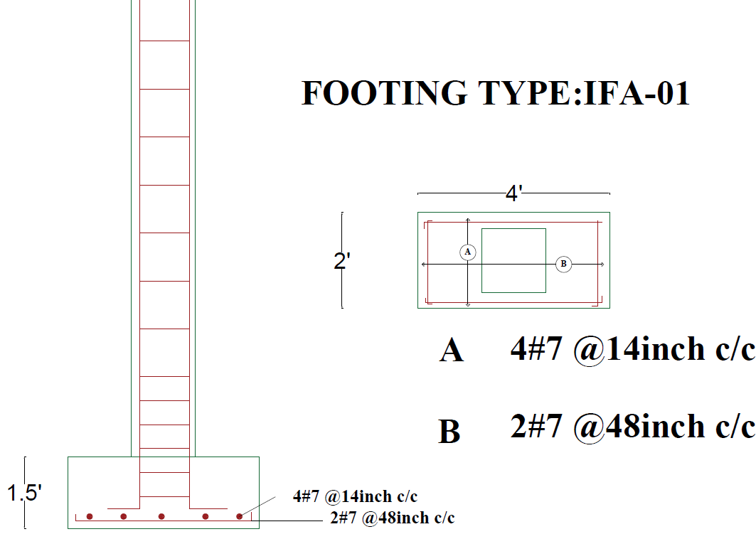
Detailing of Isolated Footing- Type 1 (Auditorium Building)

Slide 52
Plumbing
Layout and Detailing

Slide 53
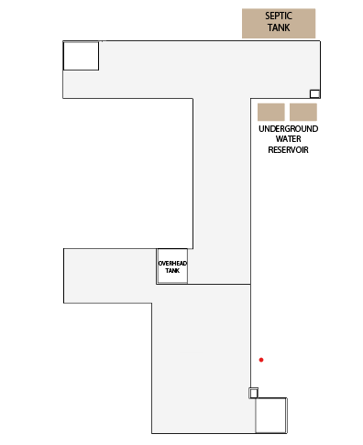
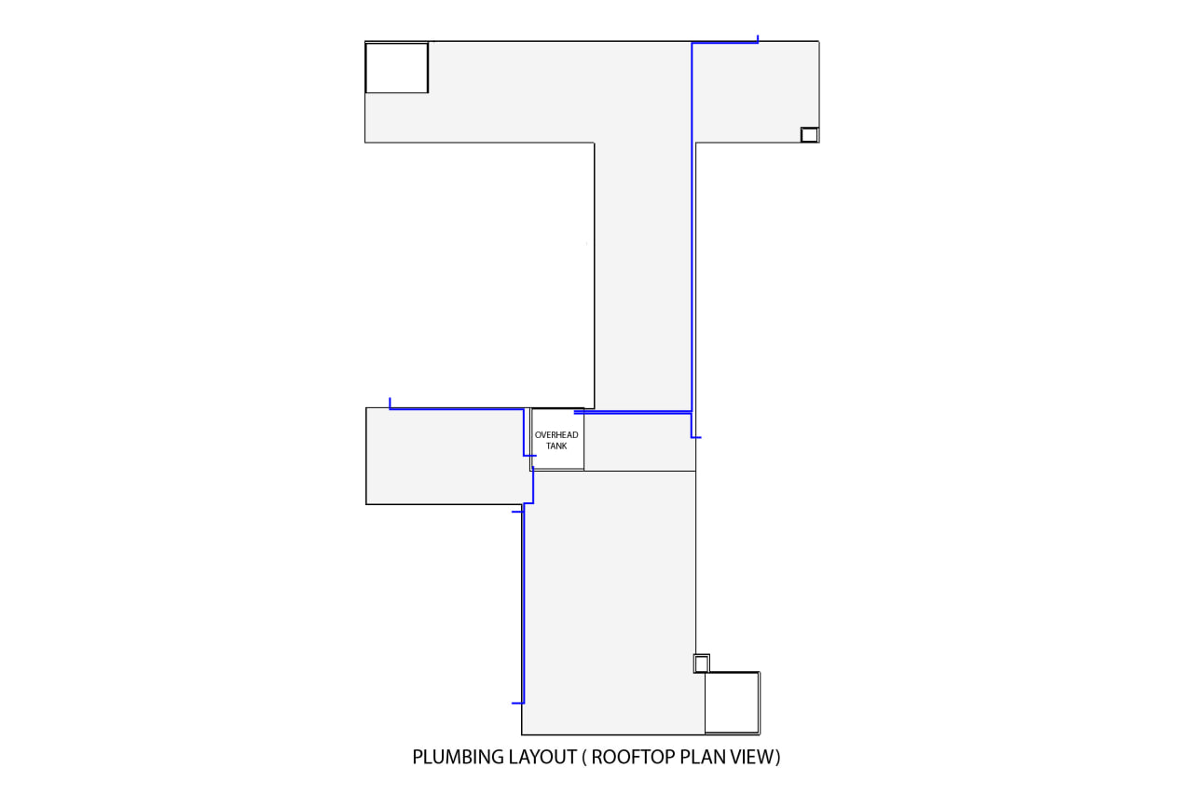
Water Is Distributed From The Overhead Tank Through 5 Inlets.
Position Of OHWT, UGWR & Septic Tank

Slide 54
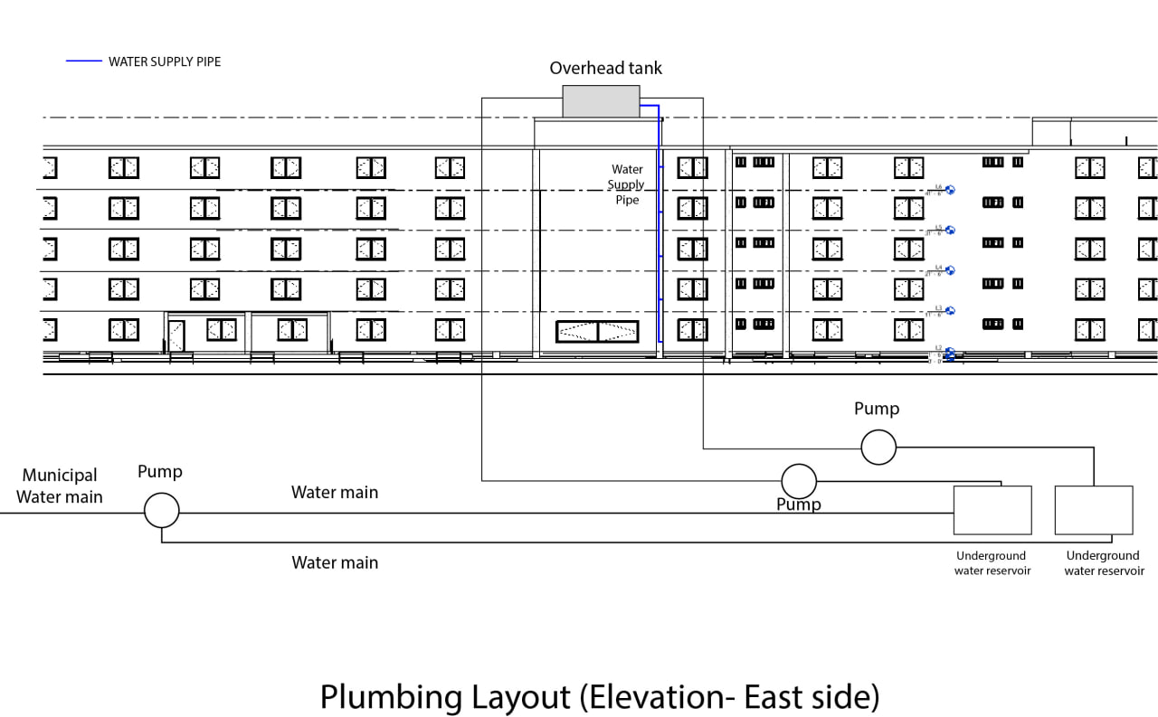
Plumbing Layout (East Side)

Slide 55
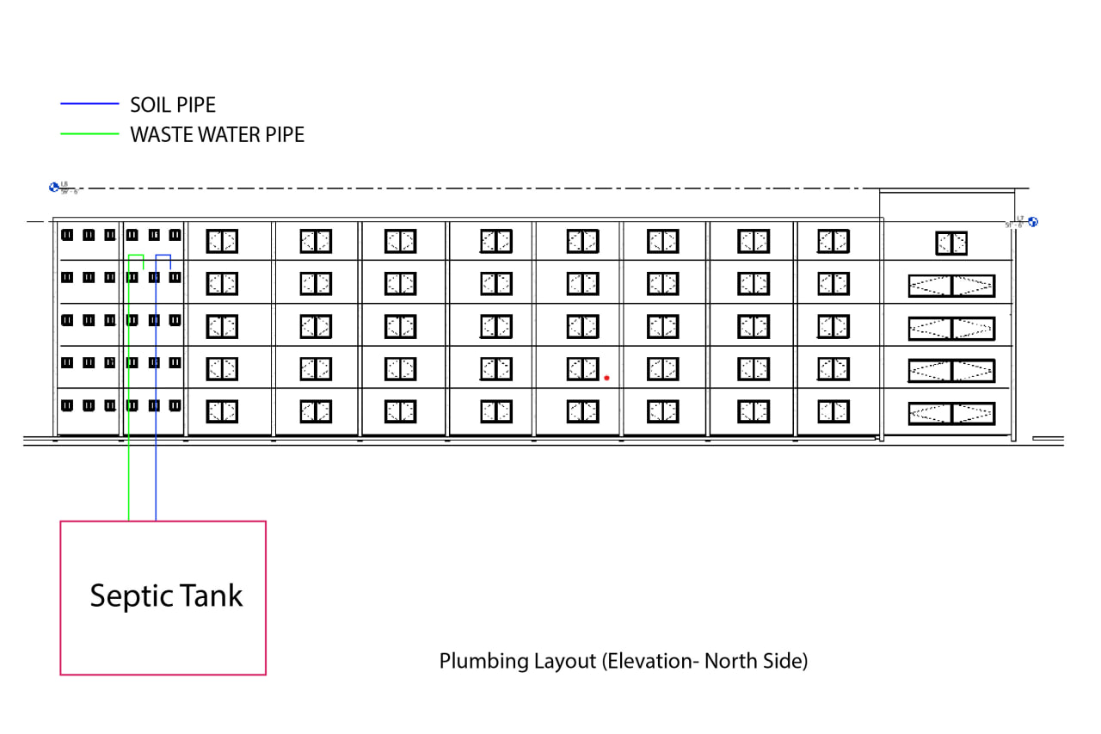
Plumbing Layout (North Side)

Slide 56
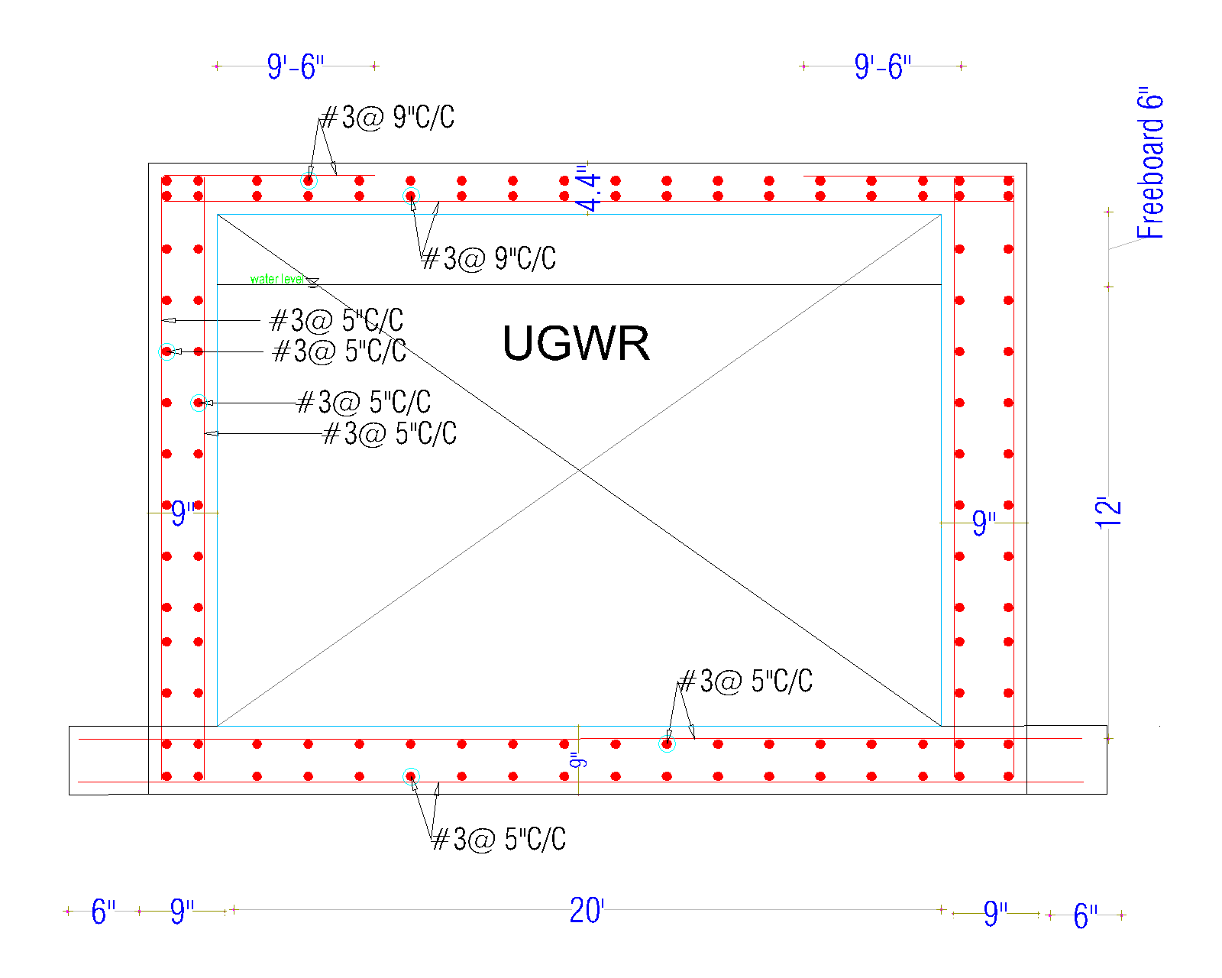
Underground Water Reservoir Detailing (Through Long Walls)
Checked against uplifting
Volume of each of the two reservoirs: 122.5 m³
Capacity sufficient to meet the school's water requirements for a consecutive 2-day period

Slide 57
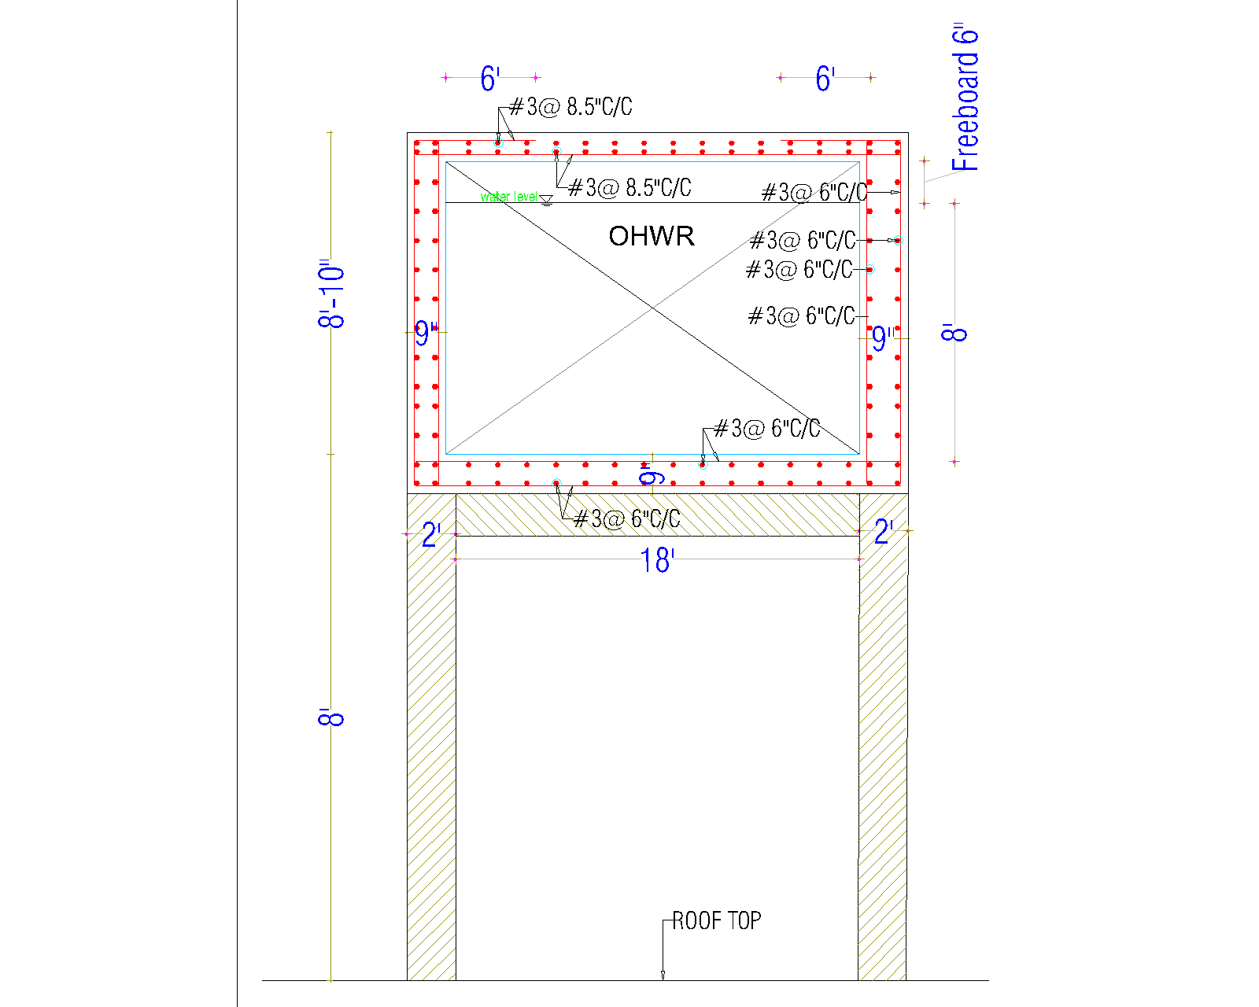
Plumbing Layout (North Side)
Placed over stair void
Volume: 61 m³
Draws water twice a day from UGWR

Slide 58
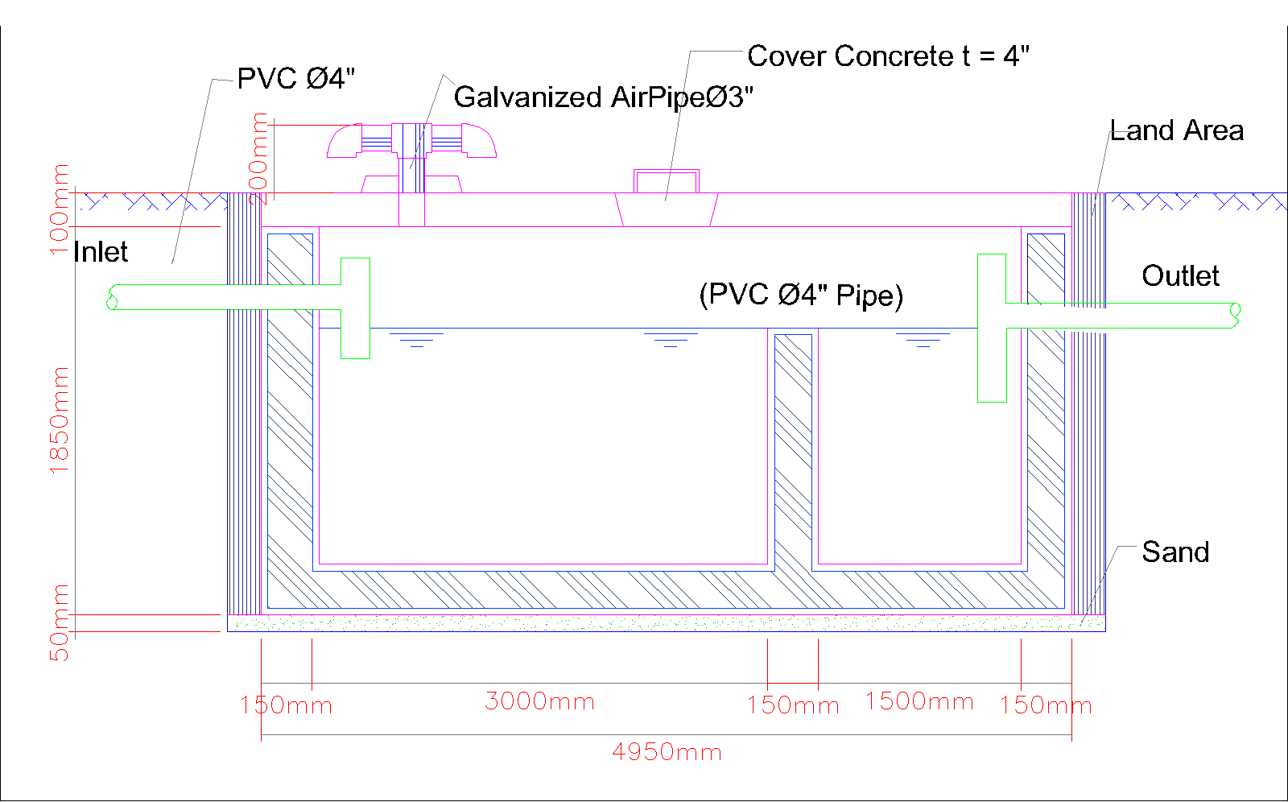
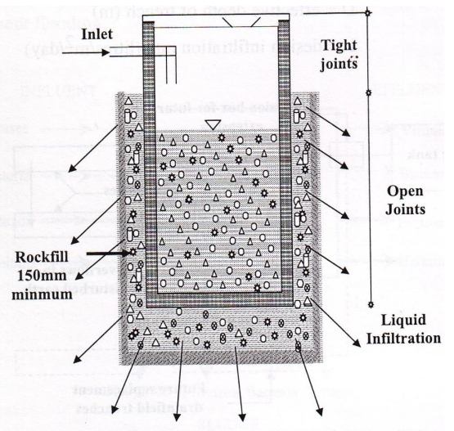
Septic Tank and Soakage Pit
Septic tank capacity: 40 meter cube
Desludging period : 3 years
Design period : 30 years
Soakage pit situated 3 m away from septic tank
Connected to storm drainage system so that it doesn’t overflow

Slide 59
Bill Of Quantity
The cost per square foot is Tk. 2,775
The cost per square foot is Tk. 2,475
Cost Per Square Foot
Academic Building
Auditorium

Slide 60
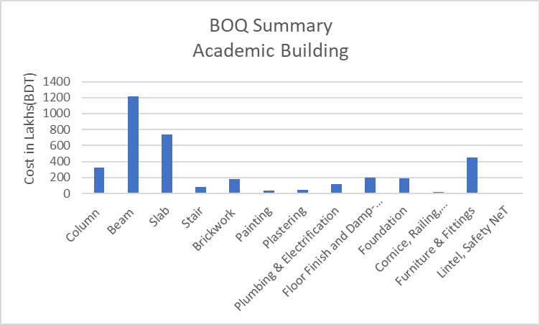
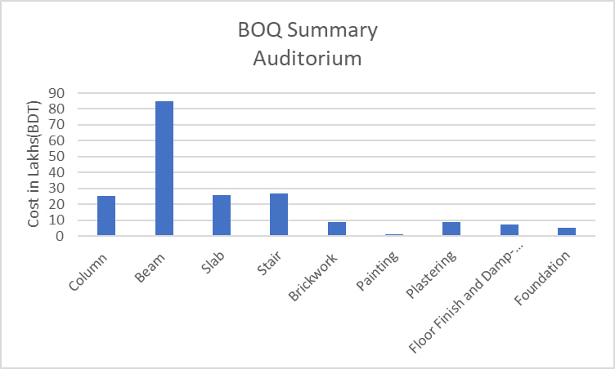

Slide 61
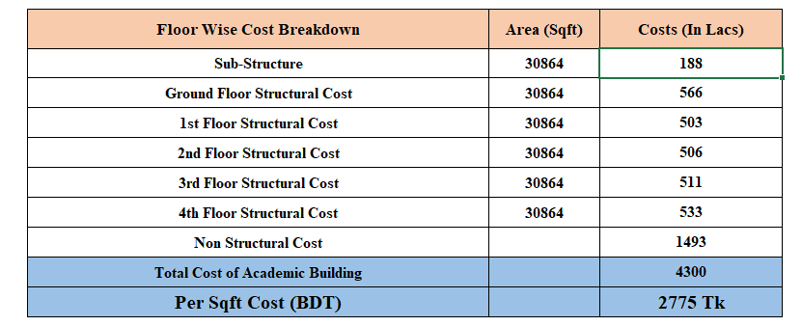
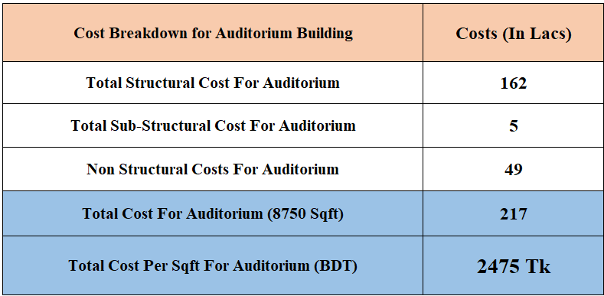
Academic Building Cost Breakdown
Auditorium Cost Breakdown

Slide 62

SWOT Analysis
STRENGTHS
S
W
WEAKNESSES
Government funded
Comprehensive Surveys
Sustainable Practices
Technological Advancements
Financial Viability
Construction Risks
Dependency on External Factors
Relocation Challenges
Initial Investment
Technology Adoption
OPPORTUNITIES
O
T
THREATS
Community Integration
Technological Learning Environment
Economic Stimulus
Long-Term Educational Impact:
Environmental Stewardship
Regulatory Changes
Public Opposition
Economic Fluctuations
Unforeseen Disasters
Technology Risks

Slide 63
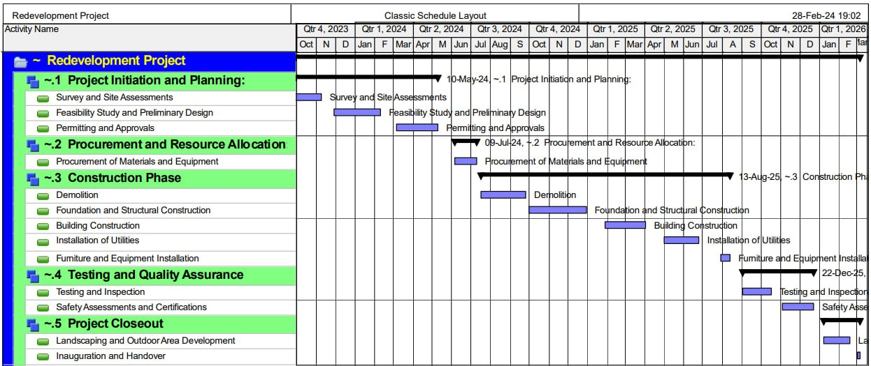
Implementation Timeline

Slide 64

Depth of Knowledge Required
Level of Interaction
Interdepence
Proficiency in structural engineering and architectural design
Familiarity with building codes and regulations
Expertise in construction management and project planning
Knowledge about modern school requirements
Stakeholder collaboration
Coordination with professionals
Compliance with environmental standards
Coordination with teachers and students
Reliance on multiple stakeholders
Integration of various systems and components
Coordination between design and construction teams
Dependencies on external factors such as weather and supply chain
.
Complex Engineering Problems
Range of Conflicting Requirements
Depth of Analysis Required
Budget versus quality considerations
Balancing aesthetics and structural integrity
Resolving stakeholder preferences
.
.
Structural analysis for earthquake resistance
Environmental impact assessments
Economicial feasibility studies
Familiarity of Issues
Innovation
Understanding of local building codes and regulations
Familiarity with green building principles
Knowledge of educational infrastructure requirements
Integration of innovative structural engineering techniques for earthquake resilience
Implementation of modern educational infrastructure and digital learning technologies
Incorporation of sustainable construction practices and green building principles

Slide 65
Extent of Stakeholder Involvement and Conflicting Requirements
Consequences for the Society and the Environment
Coordinating stakeholders' interests: government bodies, educators, students, and local community
Balancing conflicting demands: budget, safety, sustainability, and educational requirements
Facilitating communication for consensus and resolution of diverse priorities
Mitigating environmental impact through sustainable construction practices
Enhancing educational infrastructure for societal benefit
Ensuring safety and resilience of school structures for community well-being
Engineering
Activities
Complex
Range of Resources
Familiarity
Managing diverse resources including materials, labor, and funding
Ensuring efficient utilization of available resources
Addressing potential resource constraints and seeking alternative solutions
Choosing the classroom locations, lab & other room locations and selecting the right layout is a matter of much unfamiliarity for us as this is our first project.

Slide 66
THANK
YOU

